Slide 2
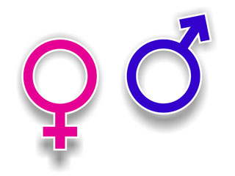
REPRESENTATION
GENDER
AO1: Demonstrate knowledge and understanding of media concepts, contexts and critical debates.
AO2: Apply knowledge and understanding when analysing media products and processes, to show how meanings and responses are created.

Slide 3
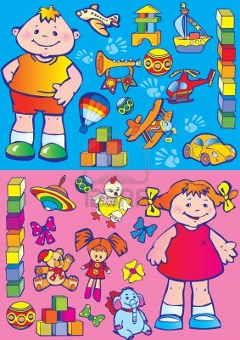
AO1: Demonstrate knowledge and understanding of media concepts, contexts and critical debates.
Gender is perhaps the basic category we use for sorting human beings. Essential elements of our own identity, and the identities we assume other people to have, come from concepts of gender - what does it mean to be a boy or a girl?

Slide 4
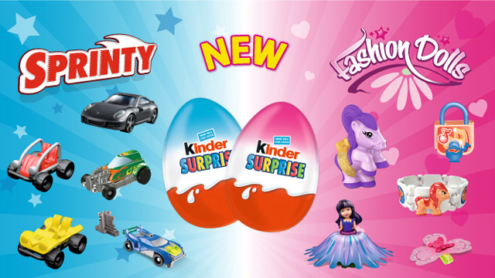
AO1: Demonstrate knowledge and understanding of media concepts, contexts and critical debates.
Many objects, not just humans, are represented by the media as being particularly masculine or feminine - particularly in advertising - and we grow up with an awareness of what constitutes 'appropriate' characteristics for each gender.

Slide 5
What do the media tell us are ‘typical’ masculine and feminine attributes?
AO1: Demonstrate knowledge and understanding of media concepts, contexts and critical debates.
List as many as you can think of:
Masculine | Feminine
tough hard sweaty active | fragile soft fragrant passive
Notice how these tend to be opposites…

Slide 6
How might the following objects be 'gendered' through advertising, given that both sexes will use the product, i.e. how will the advertisers appeal to their masculine/feminine audience? What codes and images will they use?
AO1: Demonstrate knowledge and understanding of media concepts, contexts and critical debates.
A car
A watch
Bottled beer
Toilet paper
Deodorant
Music system (iPod etc.)
Trainers
A games console

Slide 7
AO1: Demonstrate knowledge and understanding of media concepts, contexts and critical debates.
Traditional ideologies about gender
"Gender ideology refers to attitudes regarding the appropriate roles, rights, and responsibilities of women and men in society."
- Amy Kroska (American Sociological Association)

Slide 8
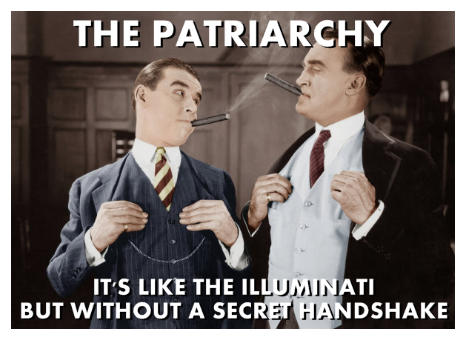
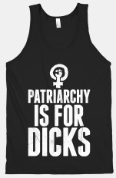
AO1: Demonstrate knowledge and understanding of media concepts, contexts and critical debates.
Traditionally, men have held the power in our society. The system where men have power and control in society is called patriarchy.
It is understood as a society run by men for men.

Slide 9
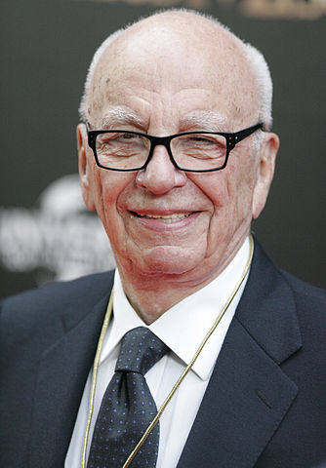
AO1: Demonstrate knowledge and understanding of media concepts, contexts and critical debates.
The result of patriarchy is that traditionally male qualities and attributes are generally seen as superior to traditionally female qualities and attributes.
The CEOs and heads of most big businesses are male, including those in the media. They naturally (unconsciously?) promote their own qualities as superior through the ideological makeup of the texts they produce.
They are also usually: straight, white and over 40... (but we’ll get to that later!)

Slide 10
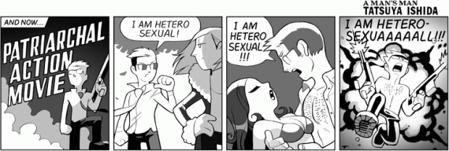
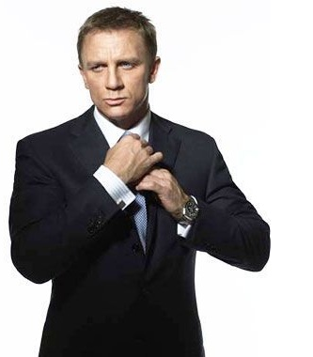
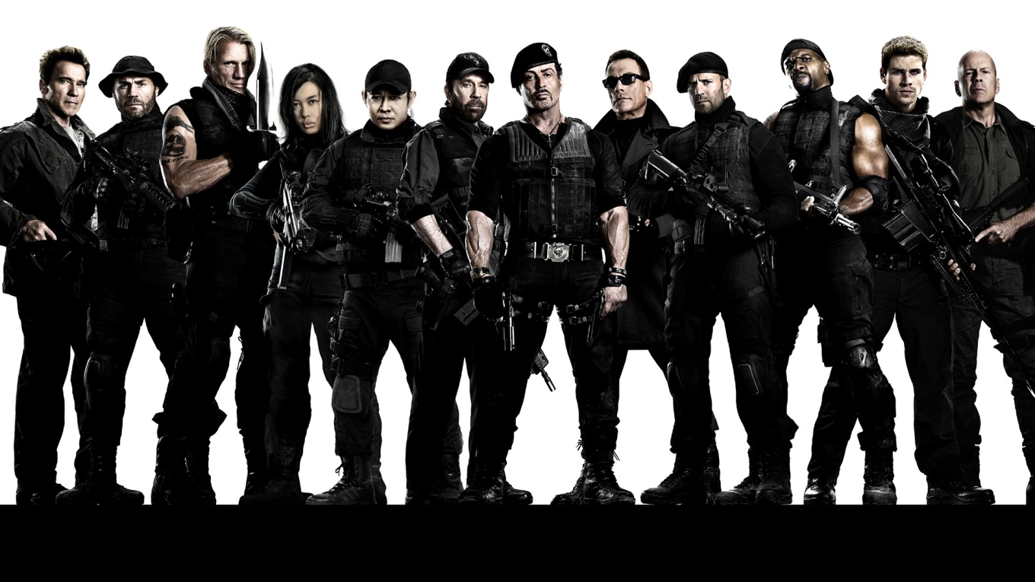
AO2: Apply knowledge and understanding when analysing media products and processes, to show how meanings and responses are created.
How do action films link to patriarchal ideas about gender? [Hint: what typical roles are assigned to men and women?]

Slide 11
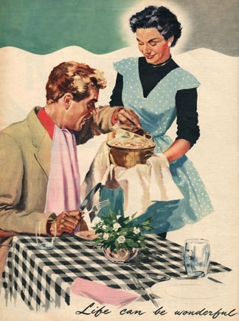
AO2: Apply knowledge and understanding when analysing media products and processes, to show how meanings and responses are created.
Two of the most common traditional roles women were represented in under patriarchy were the happy housewife and the sex object/ glamorous ideal.
How might these stereotypes suit patriarchal ideology?

Slide 12
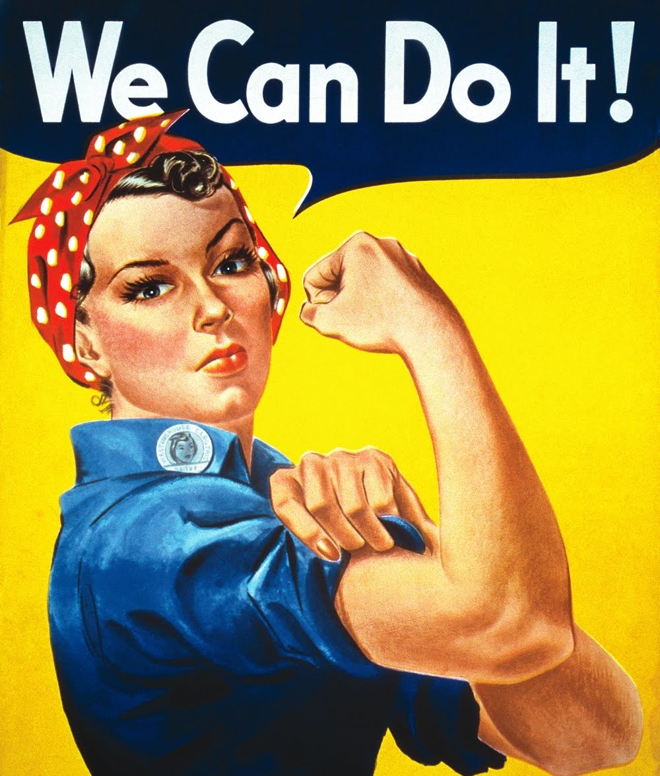
AO1: Demonstrate knowledge and understanding of media concepts, contexts and critical debates.
From the 1960s onwards, feminism challenged patriarchy. Feminism sought to gain equality for women and argued that changing representations in the media was vital to do so.
Feminism resulted in anti-sexism legislation and increased respect and opportunities for women. Suddenly gender roles were less defined in real life and this was reflected in media representations.

Slide 13
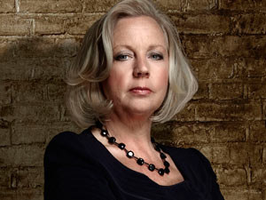
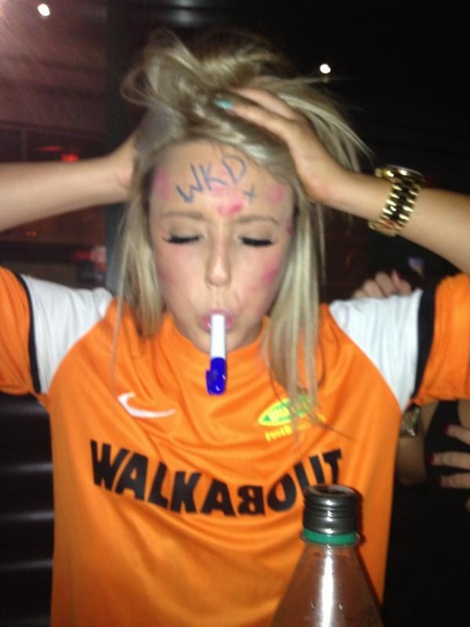
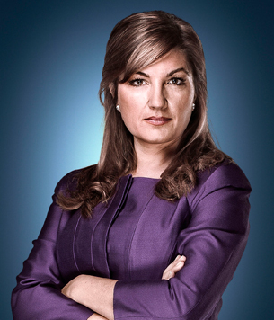
AO1: Demonstrate knowledge and understanding of media concepts, contexts and critical debates.
These representations typified the idea of women:
having a serious career
wearing trousers
smoking, drinking or swearing
playing sport (inc. football)
being ‘unable’ to cook
Roles more traditionally allocated to men.

Slide 14
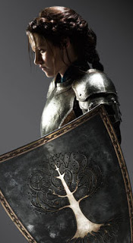
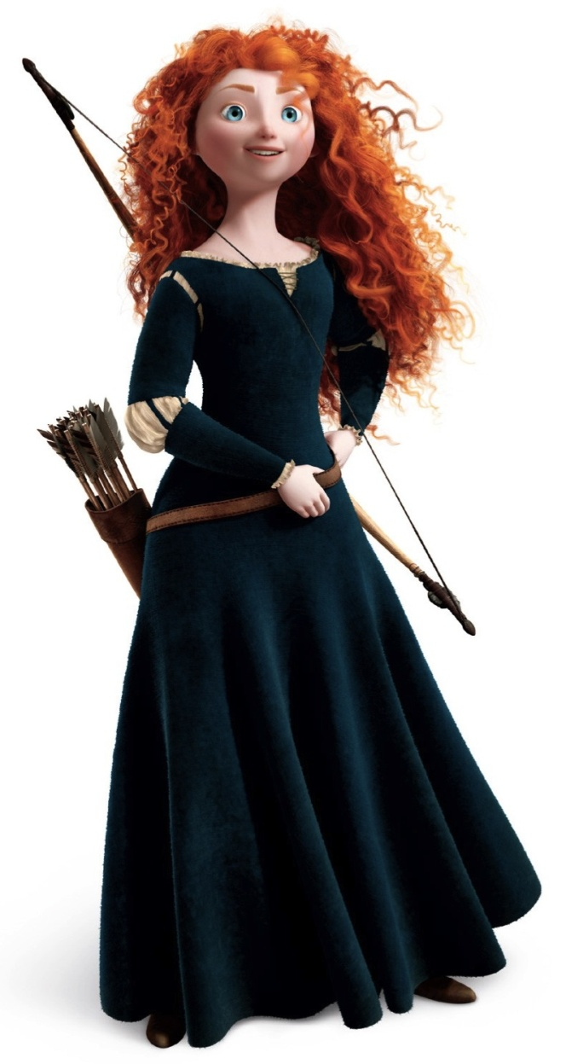
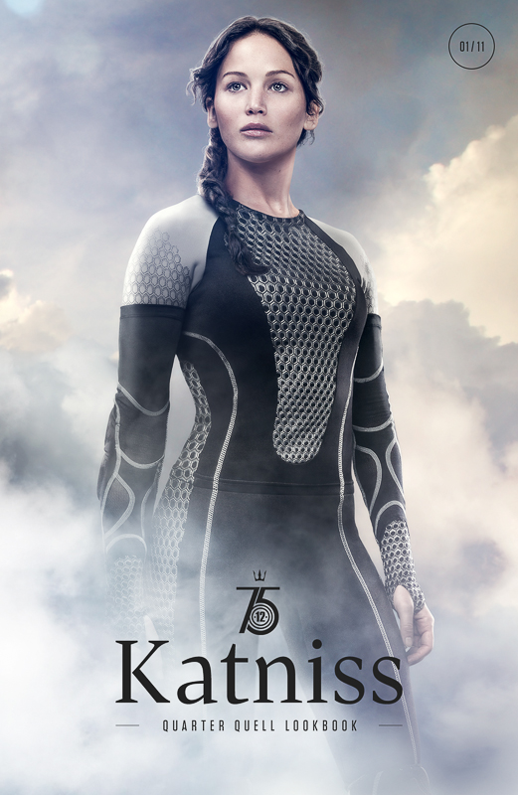
AO2: Apply knowledge and understanding when analysing media products and processes, to show how meanings and responses are created.
How do action films reflect these changes in representation?

Slide 15
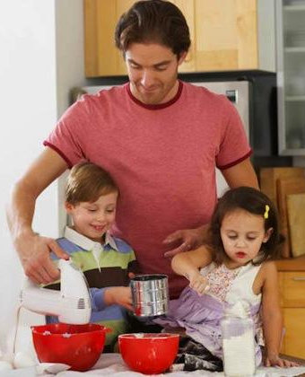
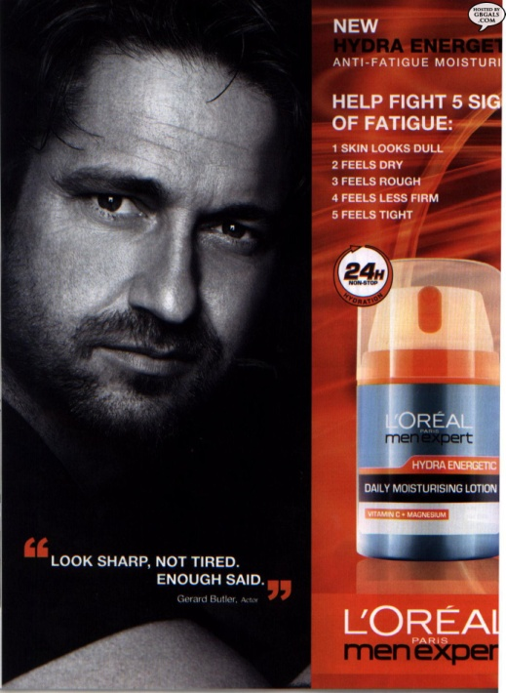
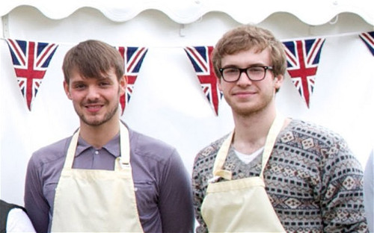
AO1: Demonstrate knowledge and understanding of media concepts, contexts and critical debates.
Men, too, have seen their represented roles change.
the house husband/ stay-at-home dad
men baking/ cooking
male grooming products
‘the new man’, in touch with his emotions
These are more traditionally ‘female’ roles, leading some to talk of ‘a crisis of masculinity’.

Slide 16
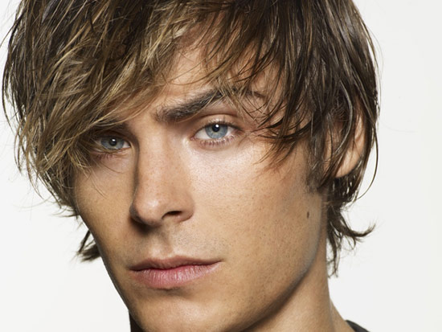
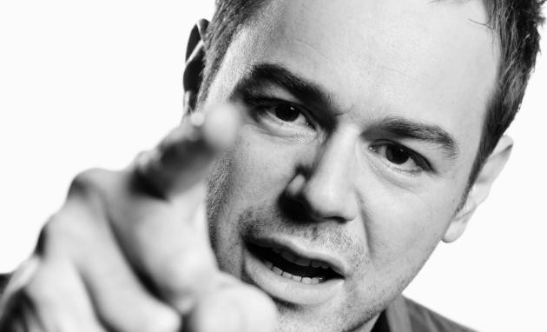
AO1: Demonstrate knowledge and understanding of media concepts, contexts and critical debates.
Some see two responses in modern masculine identity:
1. A ‘feminisation’ of the male as he adopts traditionally feminine roles and attributes, e.g. the metrosexual
2. ‘Hypermasculinity’ – an extreme macho identity aimed at making men distinct from women along traditional lines, e.g. the lad

Slide 17
AO1: Demonstrate knowledge and understanding of media concepts, contexts and critical debates.
Recent studies have shown that women are re-embracing the role of the housewife, as a right rather than a limitation.
This can be seen as a post-feminist era, where women have achieved equality and can choose their own role. This often includes adopting what were once perceived as sexist roles, like sex objects.
Some see this as a positive assertion of choice, others label it as retro-sexism and a new era of female oppression.
Post-feminist or retro-sexist?

Slide 18
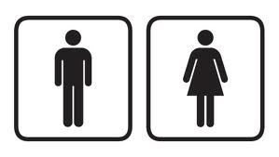
AO1: Demonstrate knowledge and understanding of media concepts, contexts and critical debates. AO2: Apply knowledge and understanding when analysing media products and processes, to show how meanings and responses are created.
Let’s look at some modern texts and try to apply some of these theoretical viewpoints.
Empowered or controlled?
Objectified?
Feminised men?
Hyper-masculine?
What qualities or attributes are present?
Patriarchal, feminist, post-feminist or retro-sexism?

Slide 19
AO1: Demonstrate knowledge and understanding of media concepts, contexts and critical debates. AO2: Apply knowledge and understanding when analysing media products and processes, to show how meanings and responses are created.
Text 1: ‘Captain America’ trailer
Text 2: Snickers ‘Inner Diva’ advert
Text 3: ‘The Heat’ trailer
Text 4: ‘Diet Coke’ advert
Text 5: ‘Invictus’ advert
Text 6: ‘Iambs’ advert
Empowered or controlled?
Objectified?
Feminised men?
Hyper-masculine?
What qualities or attributes are present?
Patriarchal, feminist, post-feminist or retro-sexism?
Watch and make notes on your text, ready to share your ideas with the class.

Slide 20
AO1: Demonstrate knowledge and understanding of media concepts, contexts and critical debates. AO2: Apply knowledge and understanding when analysing media products and processes, to show how meanings and responses are created.
What conclusions can we reach about the ways men and women are represented in the media?
Appearance
Behaviour
Relationships
Role/ function
Equilibrium/ disequilibrium
Ideology
Constructionist approach – a reminder:
The thing itself / the opinion of the encoder / reading and response of audience / context of society within which the representation takes place

Slide 21
AO1: Demonstrate knowledge and understanding of media concepts, contexts and critical debates.
Beauty (within narrow conventions)
Size/physique (within narrow conventions)
Sexuality (as emphasised by the above)
Emotional (as opposed to intellectual) dealings
Relationships (as opposed to independence/freedom)

Slide 22
AO1: Demonstrate knowledge and understanding of media concepts, contexts and critical debates.
Women are often represented as being part of a context (family, friends, colleagues) and working/thinking as part of a team.
They tend to take the role of helper (think of Propp’s theory) or object; passive rather than active.
Often their passivity extends to victimhood.
Men are still represented as TV drama characters up to 3 times more frequently than women, and tend to be the predominant focus of news stories.
The representations of women that do make it onto screen tend to be stereotypical, in terms of conforming to societal expectations.
Characters who do not fit into the mould tend to be seen as dangerous and deviant. And they get their comeuppance, particularly in the movies.

Slide 23
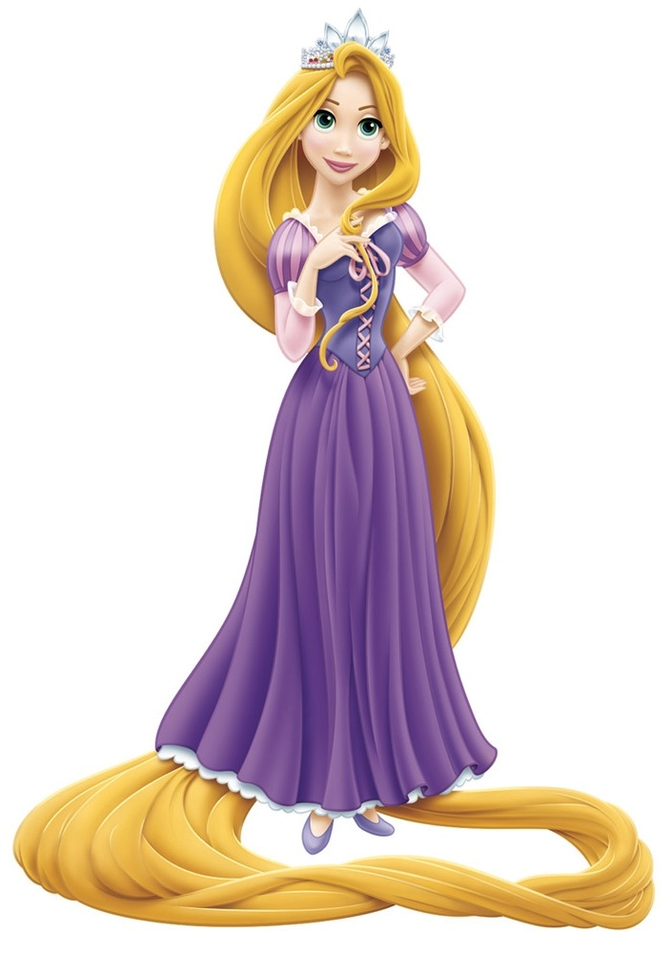
AO1: Demonstrate knowledge and understanding of media concepts, contexts and critical debates.
There are many archetypes of women in the media, but here are some of the most common:
The princess or ‘damsel in distress’ – usually a young, beautiful, virginal woman who must be rescued from some cruel fate by the Hero. Often a wide-eyed innocent, mostly an object, and almost always the prize at the end of the story. Sometimes ‘the girl next door’ – straightforward and open, with nothing concealed from the audience.
This stereotype is the most traditional (think Propp) and is not changed by simply adding a personality to the princess!

Slide 24
AO1: Demonstrate knowledge and understanding of media concepts, contexts and critical debates.
The mean girl (or popular girl) – a girl who is attractive and well-liked but is mean to less popular girls. She often has sidekicks who follow her everywhere. In recent times, this character type has gained the title ‘Queen Bee’.
She reinforces the idea that girls who know they’re beautiful and dress to accentuate it must be bad in some way. Beauty means bitchy.

Slide 25
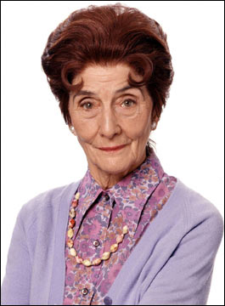
AO1: Demonstrate knowledge and understanding of media concepts, contexts and critical debates.
The Gossip – She just doesn't know when to shut up or keep a secret, regardless of whatever harm that could befall her or her companions. Whether she feels compelled to tell the truth, shares information for power or approval, or just can’t help herself, this woman reinforces the idea that women are irrational and lack control.
The ‘tart with a heart’ – a sex worker, or just a promiscuous woman, who despite her low status in life is a world-wise and compassionate person. She often has a surprisingly strong sense of morality. She sometimes acts as another form of ‘damsel in distress’ if she is rescued from her life by the romantic hero. Her sexuality is legitimised by monogamy. If not, she usually gets killed!

Slide 26
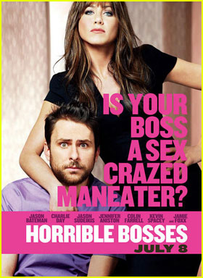
AO1: Demonstrate knowledge and understanding of media concepts, contexts and critical debates.
The Femme Fatale (including cougars!) – beautiful, seductive, but (traditionally) evil woman who leads the hero to his doom. If a cougar, an older woman who preys on and objectifies younger men for sexual gain. Sometimes combined with ‘the boss’ stereotype – an aggressive, domineering woman who belittles and abuses the men
beneath her.
These stereotypes reinforce the idea that women who take on traditionally male roles (power, sexuality) are either dangerous, evil, or lack the ability to be ‘female’ any more (domestic, emotionally aware, successful at relationships). They must either be defeated or challenged, tamed and married.

Slide 27
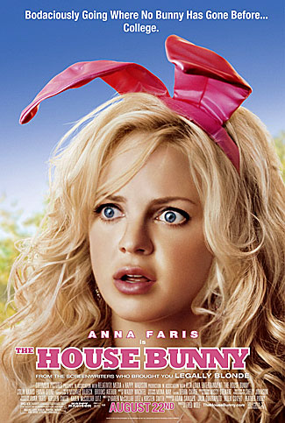
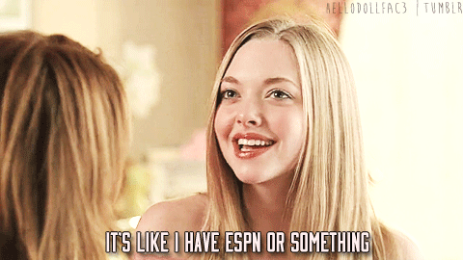
AO1: Demonstrate knowledge and understanding of media concepts, contexts and critical debates.
The dumb blonde or bimbo – often young, rich, and spoiled but usually sweet natured. Lacking intelligence. Typically a blonde-haired (not necessarily a natural blonde), bright eyed Caucasian woman who dresses in a garish, revealing fashion, often in pink. If she is the protagonist, she might reveal a surprising amount of knowledge which allows her to come out on top, usually in the field of fashion or beauty.
Other times, she just acts as comic relief.

Slide 28
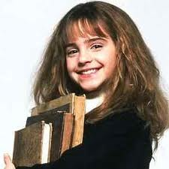
AO1: Demonstrate knowledge and understanding of media concepts, contexts and critical debates.
The rebel or bad girl – sometimes an apparent antagonist, usually a troubled and rebellious adolescent or young adult, often the black sheep of the family or social outcast. Her preferences in music, fashion or lifestyle are unconventional or non-mainstream. Closely linked to:
The nerd girl – doesn’t dress fashionably and may be intensely interested in some specialized area or notable for her intelligence. She is often kind or goodhearted.
Both of these, along with the ‘pretty ugly girl’, ’makeover girl’ or ‘Cinderella’ are explicitly contrasted with the beautiful but shallow/mean popular girl. They are attractive ‘underneath’ their mask of plainness, rebelliousness, or nerdiness and may serve as an love interest once they’ve been revealed as such.

Slide 29
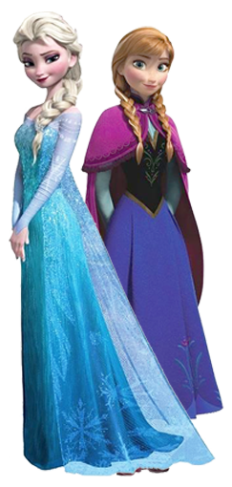
AO1: Demonstrate knowledge and understanding of media concepts, contexts and critical debates.
There are many more female archetypes, including the adventuress, the tomboy, the nurturer, and the manic dream pixie girl (!). Spend some time researching these to add to your understanding. Using what we’ve looked at so far, think about the following:
Why do you think ‘Frozen’ was hailed as a breakthrough for the representation of Disney princesses?
What sort of archetypes are used, referenced, or broken in the film?

Slide 30
AO1: Demonstrate knowledge and understanding of media concepts, contexts and critical debates.
'Masculinity' is a concept that is made up of more rigid stereotypes than femininity. Representations of men across all media tend to focus on the following:
Strength (physical and intellectual)
Power
Sexual attractiveness (which may be based on the above)
Physique
Independence (of thought and action)

Slide 31
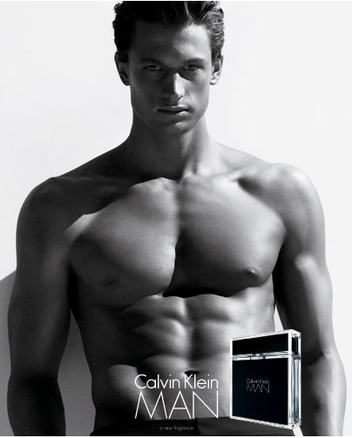
AO1: Demonstrate knowledge and understanding of media concepts, contexts and critical debates.
Male characters are often represented as isolated, as not needing to rely on others (the lone hero).
If they are part of a family, it is often part of the resolution of a narrative, rather than as part of the initial equilibrium.
The male physique is becoming more important a part of representations of masculinity. 'Serious' Hollywood actors in their forties (e.g. Brad Pitt; George Clooney) are expected to have a level of 'buffness' that was not aspired to even by young heart-throbs 40 years ago.
The ‘alpha’ male

Slide 32
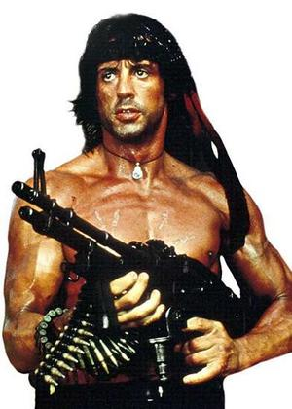
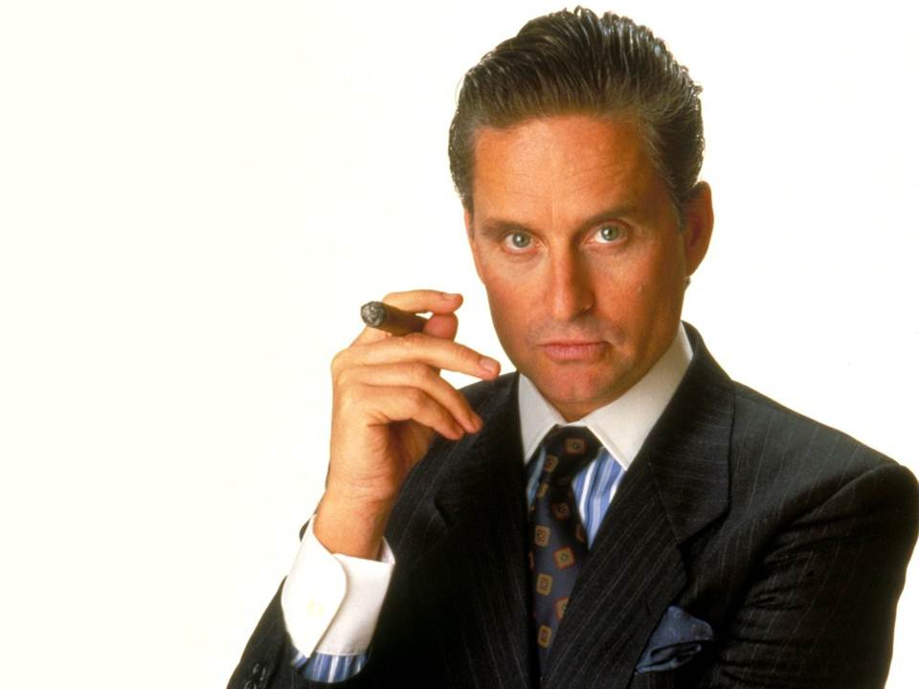
AO1: Demonstrate knowledge and understanding of media concepts, contexts and critical debates.
Research has shown that there are now seven main archetypes of men:
The big shot – defined by his professional status, he is the epitome of success. He has the characteristics and possessions that society deems desirable.
The action hero – strong but not always silent. Often angry. He is violent and aggressive.
These stereotypes suggest that a ‘real man’ must be powerful and successful.

Slide 33
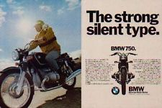
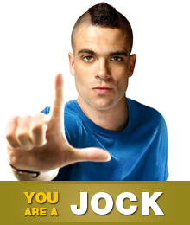
AO1: Demonstrate knowledge and understanding of media concepts, contexts and critical debates.
The strong silent type – focuses on being in charge and containing emotion, reinforcing the idea that men should always be ‘in control’ and to show emotion is weak.
The metrosexual – as already discussed.
The jock – must avoid being ‘soft’. He is aggressive, fighting other men where necessary, and shows his power and strength through physical exertion. By doing so, he wins the approval of men and the admiration of women.

Slide 34
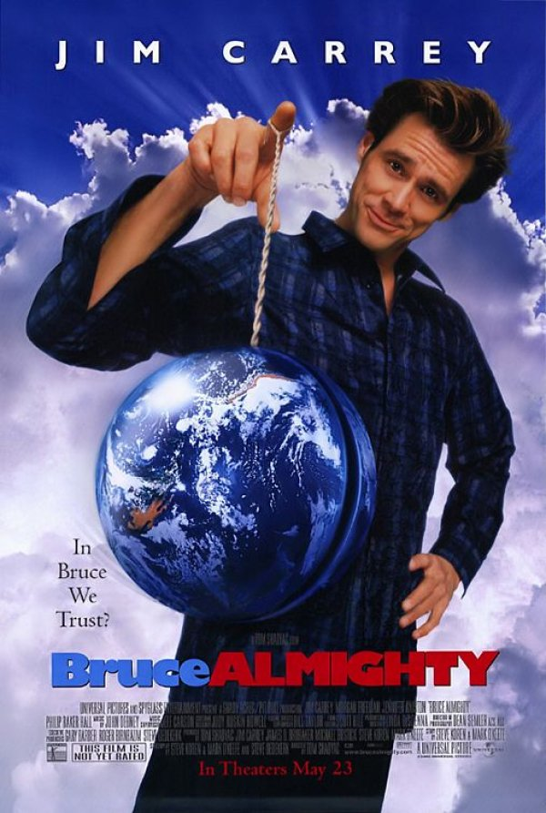
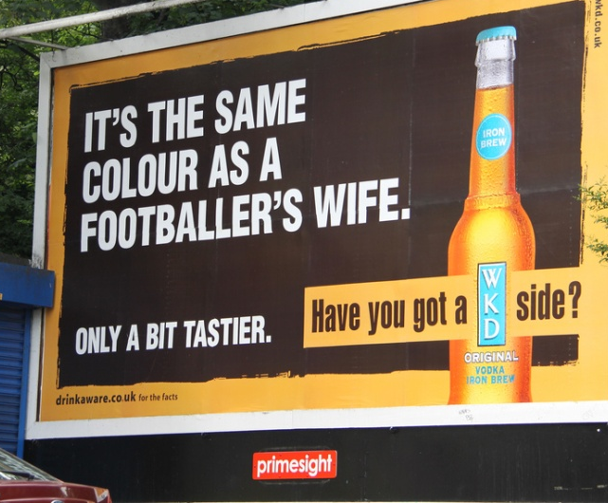
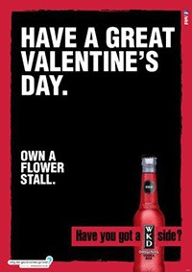
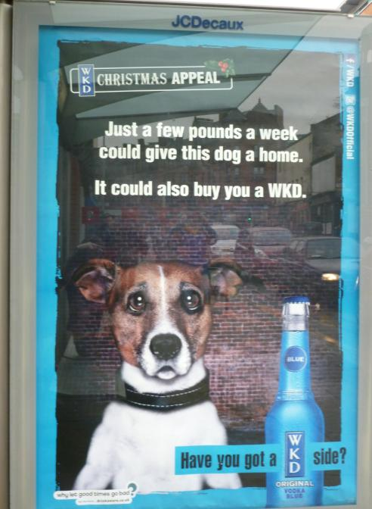
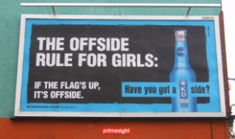
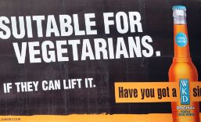
AO1: Demonstrate knowledge and understanding of media concepts, contexts and critical debates.
The joker – a popular character with other men, this stereotype suggests men should never be serious or emotional. The jokes are usually made at the expense of any available female characters or male characters exhibiting ‘female’ characteristics.

Slide 35
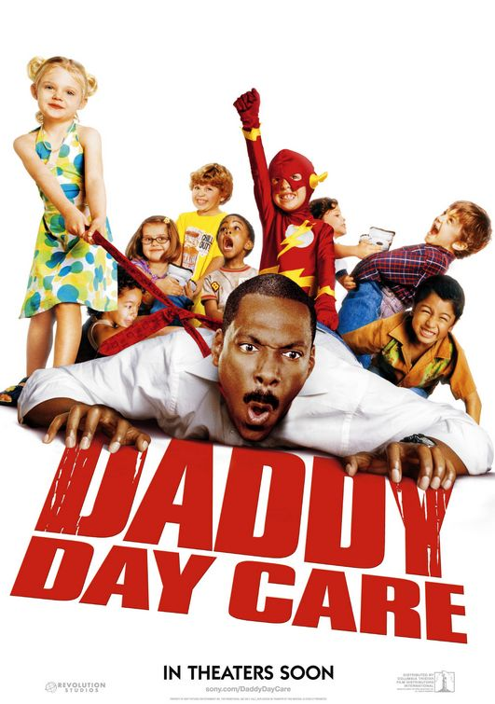
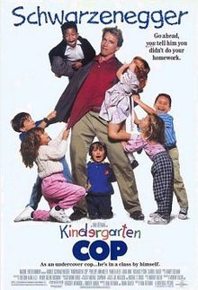
AO1: Demonstrate knowledge and understanding of media concepts, contexts and critical debates.
The fool/ buffoon – e.g. the bungling father. Usually well-intentioned and light hearted, the fool can range from slightly inept to completely hopeless in work or (more usually) parenting and domestic situations.
This might seem like a negative representation however...
it stresses the ‘unsuitability’ of men for a domestic role, reinforcing patriarchal ideologies
they always come out on top in the end!

Slide 36
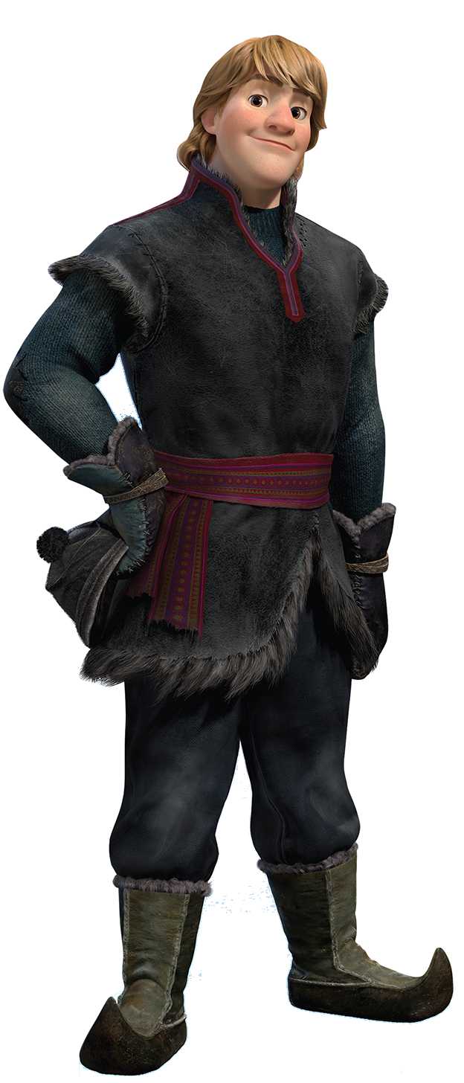
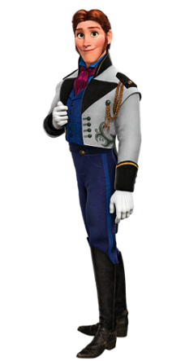
AO1: Demonstrate knowledge and understanding of media concepts, contexts and critical debates.
Is ‘Frozen’ as interesting in its representation of men compared to its representation of women?
What sort of archetypes are used, referenced, or broken in the film?

Slide 37
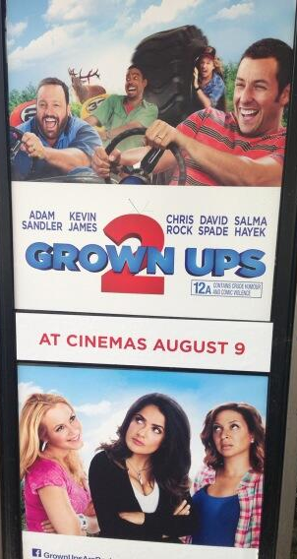
AO1: Demonstrate knowledge and understanding of media concepts, contexts and critical debates.
Binary opposites in male representation
If men cannot fulfil the stringent criteria for ‘alpha’ maledom, they are relegated to ‘beta’ male status. Foolish, childish and prone to error, these men are celebrated through adverts, TV shows (e.g. Jackass) and films.
Women’s role in this is to either create the beta male by belittling or dominating him, or to disapprove of him (often within a marriage or relationship), acting as ‘the straight man’ if not the prize.

Slide 38
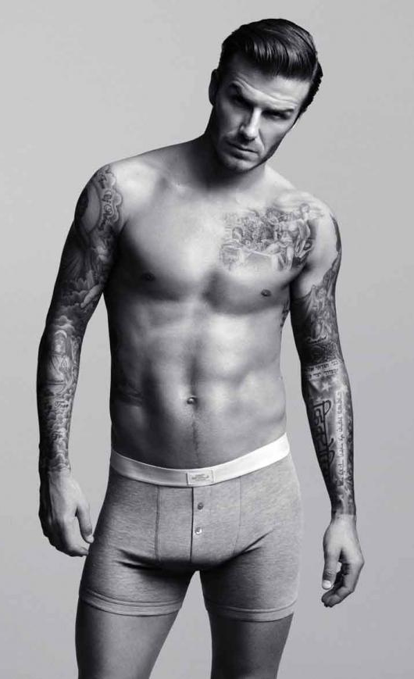
AO1: Demonstrate knowledge and understanding of media concepts, contexts and critical debates.
Is there a middle ground between alpha and beta men? Yes!
David Beckham is an alpha male, but he is also a ‘metrosexual’ and is objectified for female (and male) audiences. (Bear this in mind when we consider ‘the gaze’ later on.)
He is part of a family unit and his narratives often revolve around this aspect of his life.
How does this representation affect his mainstream appeal?

Slide 39
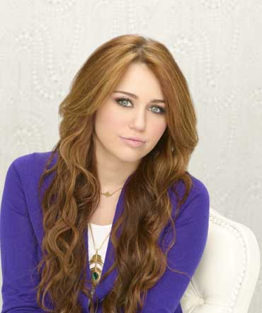
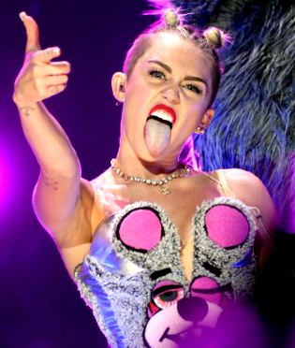
AO1: Demonstrate knowledge and understanding of media concepts, contexts and critical debates.
Binary opposites in female representation:
‘Good’ girls and ‘bad’ girls
Wife, mother. Subservient, Compliant. Docile. Domesticated. Virtuous. Sexy and Attractive. Available (to partner).
Single, independent. Belligerent. Unruly. Outspoken/ aggressive. Sluttish. Immoral. Overtly Sexual. Available (to anyone).
Men’s role in this is typically to protect or objectify.
Or both.

Slide 40
AO1: Demonstrate knowledge and understanding of media concepts, contexts and critical debates.
Is there a middle ground between ‘good’ girls and ‘bad’ girls? No!
Research shows that traditional patriarchal discourse (and the media) is saturated with this binary opposite: the madonna/whore dichotomy.
Sue Lees conducted research into the impact of these stereotypes on the perceptions of police and judges involved in rape trials. She found that they contributed to the common attitude that some women are “asking for it”.
How does Rhianna’s ‘bad girl’ persona/ representation affect her mainstream appeal?

Slide 41
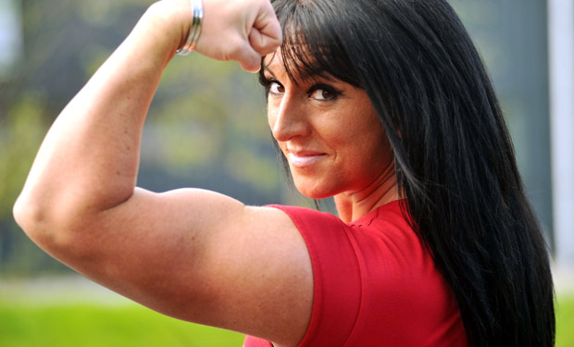
GENDERTROUBLE?
How do these pictures challenge assumptions on gender?

Slide 42
AO1: Demonstrate knowledge and understanding of media concepts, contexts and critical debates.
Judith Butler: theorist of power, gender, sexuality and identity. She wrote ‘Gender Trouble’.
Butler suggests that gender is not the result of nature but is socially constructed e.g. male and female behaviour and roles are not the result of biology but are constructed and reinforced by society through media and culture.
Rather than being a fixed attribute in a person, she argues that gender should be seen as a fluid variable which shifts and changes in different contexts and at different times. However, the media reinforces and exaggerates stereotypical ‘male’ and ‘female’ behaviour, which we adopt as ‘normal’. In this way, gender becomes a performance, with the media providing the script.

Slide 43
AO1: Demonstrate knowledge and understanding of media concepts, contexts and critical debates.
Judith Butler: ‘gender performance’ and Lady Gaga
Maleness and masculinity, in this case, are being performed through Lady Gaga’s actions and choices, rather than being a trait that pre-exists within the individual.

Slide 44
AO1: Demonstrate knowledge and understanding of media concepts, contexts and critical debates.
Judith Butler: ‘gender performance’ and Lady Gaga
“I love the rumour that I have a penis. I'm fascinated by it. In fact, it makes me love my fans even more that this rumour is in the world because 17,000 of them come to an arena every night and they don't care if I'm a man, a woman, a hermaphrodite, gay, straight, transgendered, or transsexual.”

Slide 45
AO1: Demonstrate knowledge and understanding of media concepts, contexts and critical debates.
Judith Butler and Queer Theory
Note: Queer Theory isn’t just about homosexuality. It also explores cross-dressing, gender-ambiguity, gender-corrective surgery and intersexual identity.
Queer Theory explores and challenges the way in which heterosexuality is constructed as normal and homosexuality as deviant.
The media has historically limited the representations of gay men and women. Hollywood films, TV ads, and other mainstream texts often construct images of ‘normal’ happy heterosexual couples, but homosexual couples are often represented in terms of sin, sickness or shame. Think about how many gay soap characters are involved in extra-marital affairs! This is, however, changing...

Slide 46
AO1: Demonstrate knowledge and understanding of media concepts, contexts and critical debates.
‘Camp’: challenging notions of ‘masculinity’
The word ‘camp’ is linked to Queer Theory – it involves an exaggerated performance of femininity, usually by men. It involves an emphasis on style, image, breaking of taboos and poking fun at authority and is often used in comedy, game and chat shows. Historically, it is linked to homosexuality but…

Slide 47
AO1: Demonstrate knowledge and understanding of media concepts, contexts and critical debates.
Judith Butler and Queer Theory
Queer Theory challenges the traditionally held assumptions that there is a binary divide between being gay and heterosexual and suggests sexual identity is more fluid. This fits with Butler’s ideas of ‘gender trouble’.
Look the examples opposite:
ironic and ‘over-the-top’ performances
over-elaborate costumes and make-up
use feminine and camp gestures
not ‘macho’
camp but not necessarily gay
Can you think of any others?

Slide 48
AO1: Demonstrate knowledge and understanding of media concepts, contexts and critical debates.
How does ‘Orange is the New Black’ fit with Butler’s ideas of gender trouble and/or challenge traditional notions of femininity?

Slide 49
AO1: Demonstrate knowledge and understanding of media concepts, contexts and critical debates.
How does ‘Orange is the New Black’ fit with Butler’s ideas of gender trouble and/or challenge traditional notions of femininity?

Slide 50
AO1: Demonstrate knowledge and understanding of media concepts, contexts and critical debates.
How does Jodie Marsh fit with Butler’s ideas of gender trouble and/or challenge traditional notions of femininity?

Slide 51
AO1: Demonstrate knowledge and understanding of media concepts, contexts and critical debates.
How Kellie Maloney and Laverne Cox fit with Butler’s ideas of gender trouble and/or challenge traditional notions of gender? Is this gender as performance or more than that?
Can we separate representation from reality?

