Slide 2
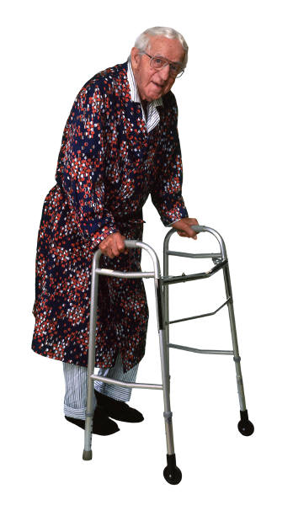
REPRESENTATION
AGE
AO1: Demonstrate knowledge and understanding of media concepts, contexts and critical debates.

Slide 3
AO1: Demonstrate knowledge and understanding of media concepts, contexts and critical debates.
What does the media tell us is a typical teenager?
A typical elderly person?
Draw and dress your representation, considering:
Appearance
Behaviour
Speech
Relationships with others

Slide 4
AO1: Demonstrate knowledge and understanding of media concepts, contexts and critical debates.
Was your representation:
Positive?
Negative?
Problematic?
Where did you get your information from?
Did you take a dominant or negotiated reading?

Slide 5
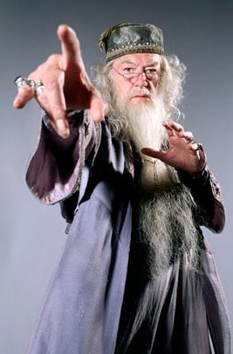
AO1: Demonstrate knowledge and understanding of media concepts, contexts and critical debates.
Focus on typical ideologies about the elderly
Research focusing on media representations of the elderly suggests that age is not the only factor that impacts on the way the media portrays elderly people.
Newman (2006) notes that upper class and middle class elderly people are often portrayed in television and film dramas as occupying high-status roles as world leaders, judges, politicians, experts and business executives.

Slide 6
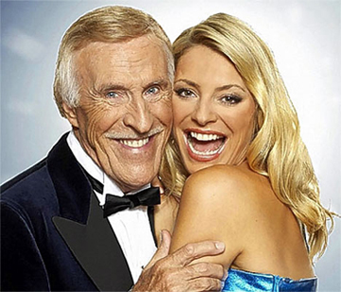
AO1: Demonstrate knowledge and understanding of media concepts, contexts and critical debates.
Moreover, TV programmes seem to work on the assumption that an older male with grey in his hair and lines on his face somehow has the necessary authority to impart the news (or host a light entertainment programme).
However, these older men are often paired with attractive young females, while older women newsreaders and presenters are often exiled to radio. Leading female film and television stars are also often relegated to character parts once their looks and bodies are perceived to be on the wane, which seems to be after the age of 40.

Slide 7
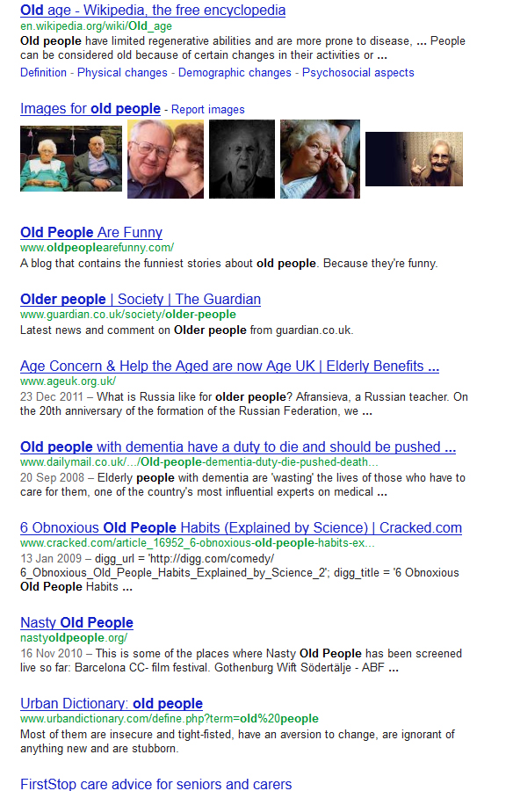
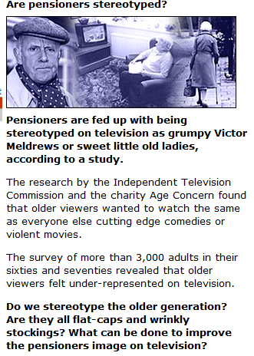

Slide 8
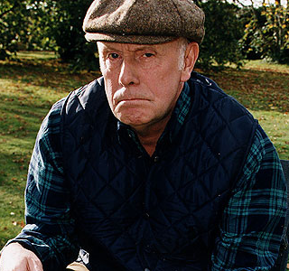
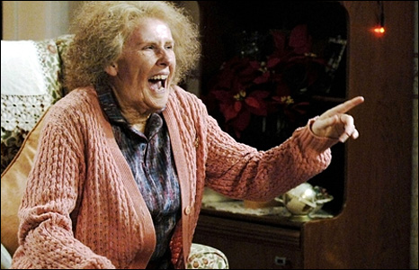
AO1: Demonstrate knowledge and understanding of media concepts, contexts and critical debates.
Sociological studies show that when the elderly do appear in the media, they tend to be portrayed in the following one-dimensional ways:
As grumpy – conservative, stubborn and resistant to social change.

Slide 9
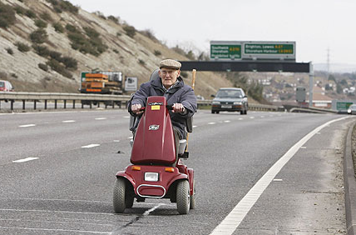
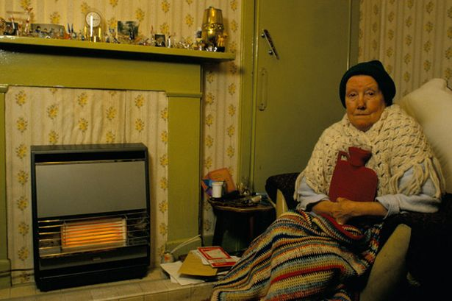
AO1: Demonstrate knowledge and understanding of media concepts, contexts and critical debates.
As mentally challenged – suffering from declining mental functions.
As dependent – helpless and dependent on other younger members of the family or society.

Slide 10
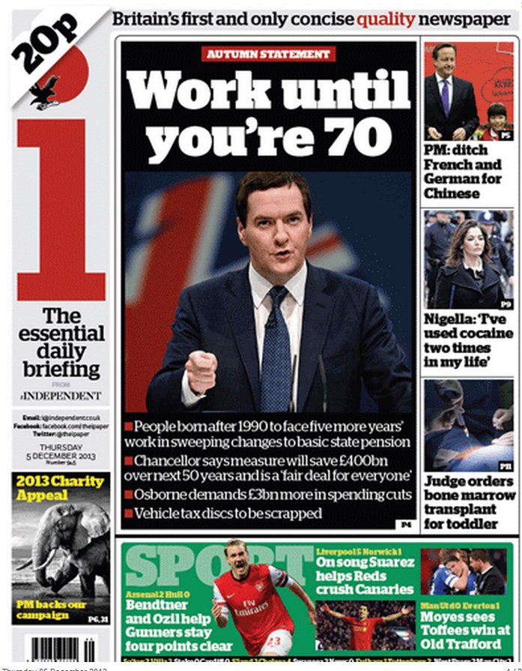
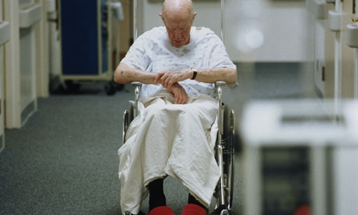
AO1: Demonstrate knowledge and understanding of media concepts, contexts and critical debates.
As a burden – as an economic burden on society (in terms of the costs of pensions and health care to the younger generation) and/or as a physical and social burden on younger members of their families.

Slide 11
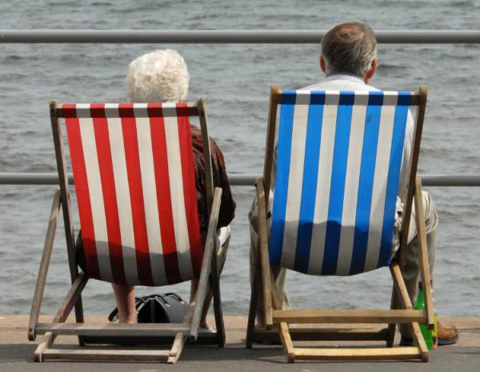
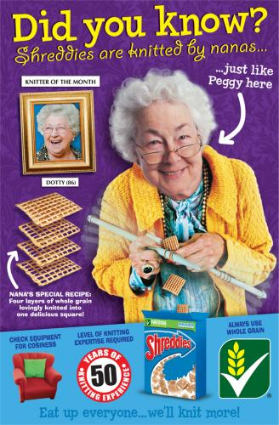
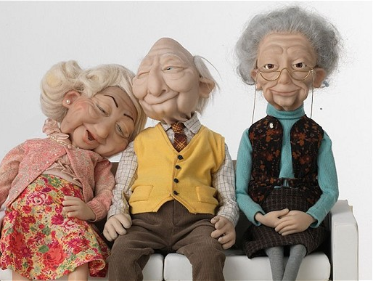
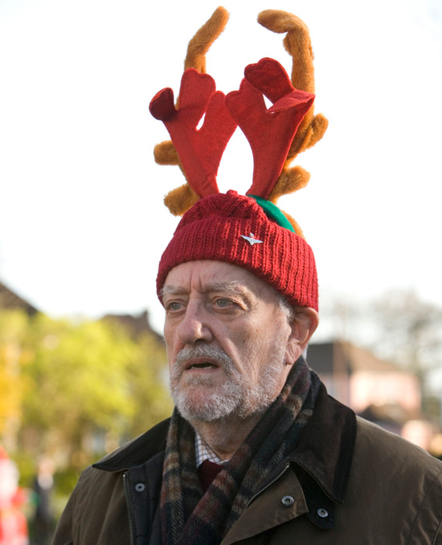
AO1: Demonstrate knowledge and understanding of media concepts, contexts and critical debates.
As enjoying a second childhood – as reliving their adolescence and engaging in activities that they have always longed to do before they die.
Or just being a bit cheeky.

Slide 12
AO1: Demonstrate knowledge and understanding of media concepts, contexts and critical debates.
However, recent research suggests that media producers may be gradually reinventing how they deal with the elderly, especially as they realise that this group may have disposable incomes, i.e. extra money to spend on consumer goods.

Slide 13
AO1: Demonstrate knowledge and understanding of media concepts, contexts and critical debates. AO2: Apply knowledge and understanding when analysing media products and processes, to show how meanings and responses are created.
Let’s look at some adverts featuring the elderly. Make notes on your given advert and be prepared to share your ideas with the class.
Does your advert represent the elderly in a stereotypical or challenging way?
Text 1: Shreddies ‘ding dong’ advert Text 2: Wonga ‘sliders’ advert
Text 3: Age UK ‘thank you’ advert Text 4: Guinness ‘swimmer’ advert
Constructionist approach – a reminder:
The thing itself / the opinion of the encoder / reading and response of audience / context of society within which the representation takes place

