Slide 2
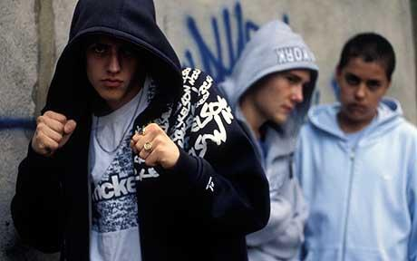
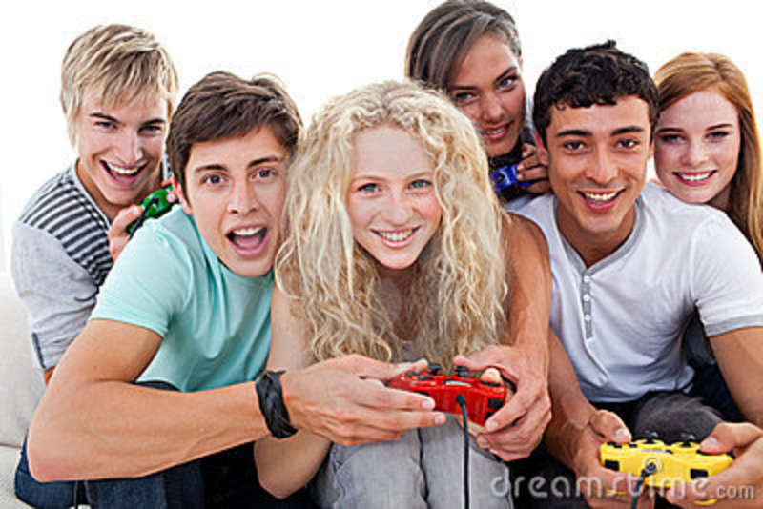
AO1: Demonstrate knowledge and understanding of media concepts, contexts and critical debates.
Focus on typical ideologies about teenagers
There are generally two very broad ways in which young people have been targeted and portrayed by the media in Britain.
Dick Hebdige in his ‘Subcultures’ book (1979) identified these two representations:
Teenagers as ‘trouble’
Teenagers as ‘fun’

Slide 3
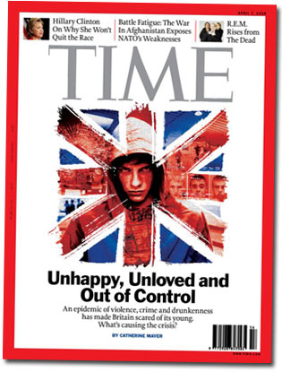
AO1: Demonstrate knowledge and understanding of media concepts, contexts and critical debates.
Teenagers as ‘trouble’
Youth are often portrayed by news media as a social problem, as immoral or anti-authority and consequently constructed as ‘folk devils’ as part of a moral panic.
The majority of moral panics since the 1950s have been manufactured around concerns about young people’s behaviour, such as their membership of specific ‘deviant’ sub-cultures (e.g., teddy boys, hoodies) or because their behaviour (e.g., drug taking or binge drinking) has attracted the disapproval of those in authority.

Slide 4
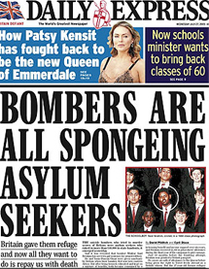
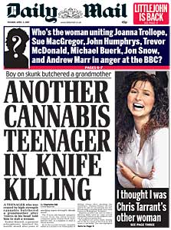
AO1: Demonstrate knowledge and understanding of media concepts, contexts and critical debates.
What is a moral panic?
A moral panic is the intensity of feeling expressed in a population about an issue that seems to threaten the social order.

Slide 5
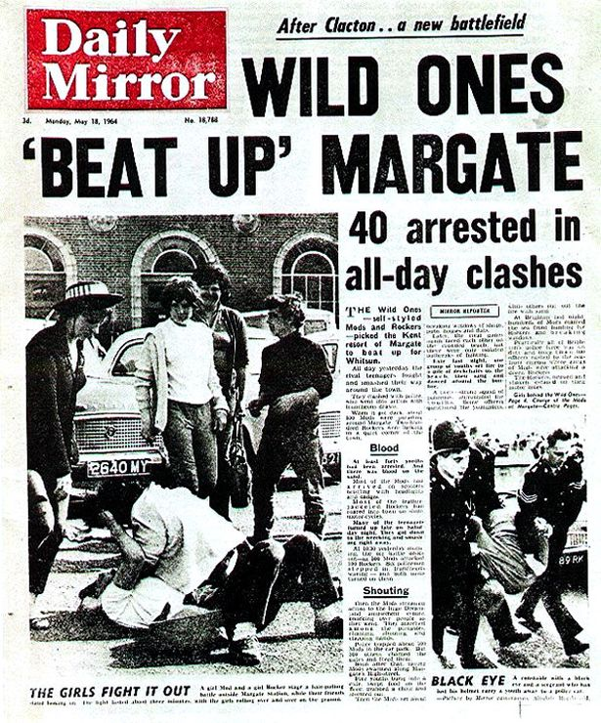
AO1: Demonstrate knowledge and understanding of media concepts, contexts and critical debates.
According to Stanley Cohen, author of Folk Devils and Moral Panics (1972), a moral panic occurs when "[a] condition, episode, person or group of persons emerges to become defined as a threat to societal values and interests."
Those deviant groups were labelled by Stanley Cohen as folk devils. He identified teenagers as one subculture labelled this way.

Slide 6
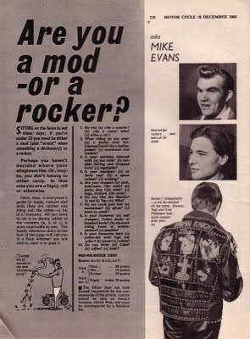
AO1: Demonstrate knowledge and understanding of media concepts, contexts and critical debates.
Cohen based his theory on the media reporting of conflicts between two teenage tribes of the 1960s, the Mods and the Rockers.
The main criticism was that they were seen as a threat to law and order largely through the way the mass media represented them, in the form of what Cohen calls the 'control culture'. Largely this refers to the media sensationalising an event and then calling for a punishment to be set to persecute the offenders.

Slide 7
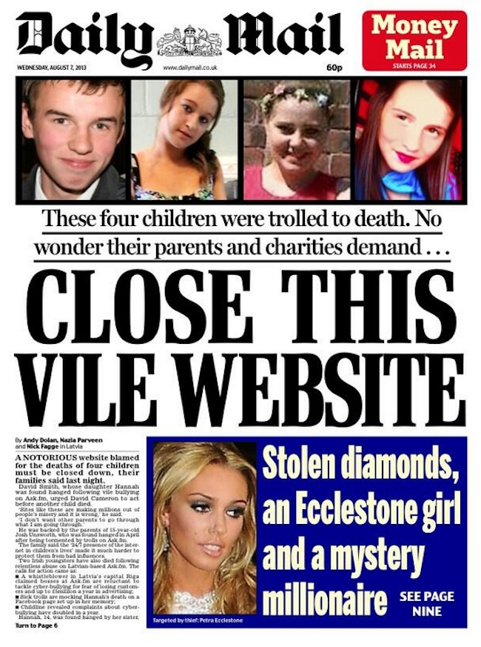
AO1: Demonstrate knowledge and understanding of media concepts, contexts and critical debates.
The five characteristics of a moral panic
Concern – awareness that the behaviour of the folk devils is likely to have a negative impact on society.
Hostility – a clear division between ‘them’ and ‘us’.
Consensus – widespread acceptance that the group in question causes a real threat to society. The ‘moral entrepreneurs’ are vocal at this stage.
Disproportionality – the action taken is disproportionate to the actual threat by the accused group.
Volatility – moral panics tend to disappear as quickly as they are formed, due to a wane in public interest or the focus of the news changing to another topic.

Slide 8
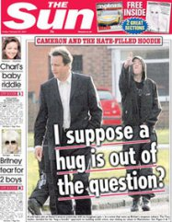
AO1: Demonstrate knowledge and understanding of media concepts, contexts and critical debates.
Are teenagers a moral panic?
Wayne et al. (2008) conducted a content analysis of 2130 news items across all the main television channels during May 2006. They found that young people were mainly represented as a violent threat to society. They found that it was very rare for news items to feature a young person’s perspective or opinion. They note that the media only delivers a one-dimensional picture of youth, one that encourages fear and condemnation rather than understanding. Moreover, they argue that it distracts from the real problems that young people face in the modern world such as homelessness, not being able to get onto the housing ladder, unemployment or mental health and that these might be caused by society’s, or the government’s, failure to take the problems of youth seriously

Slide 9
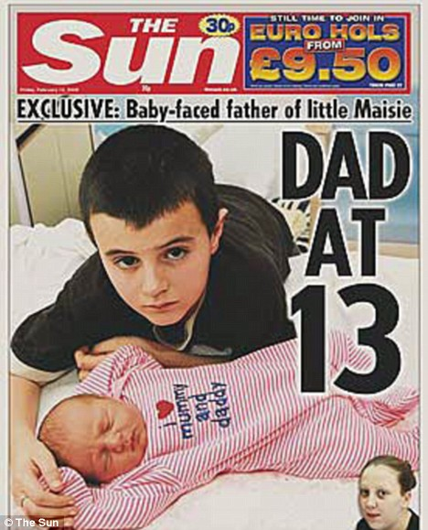
AO1: Demonstrate knowledge and understanding of media concepts, contexts and critical debates.
Why are teenagers represented negatively?
What about this negative representation appeals to society’s dominant (hegemonic) ideology?
Teenagers become a scapegoat for fears about family breakdown, violence in society, consumerism etc.
Teenagers have no ‘voice’ so cannot fight back.
Teenagers have their own culture (values and behaviours) which differs from the established adult culture.

Slide 10
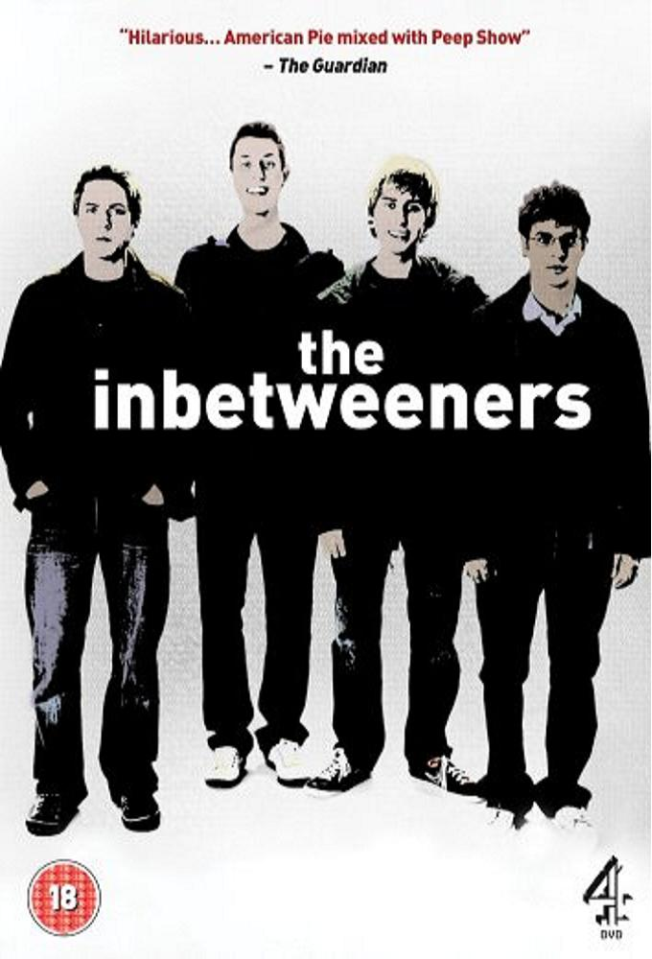
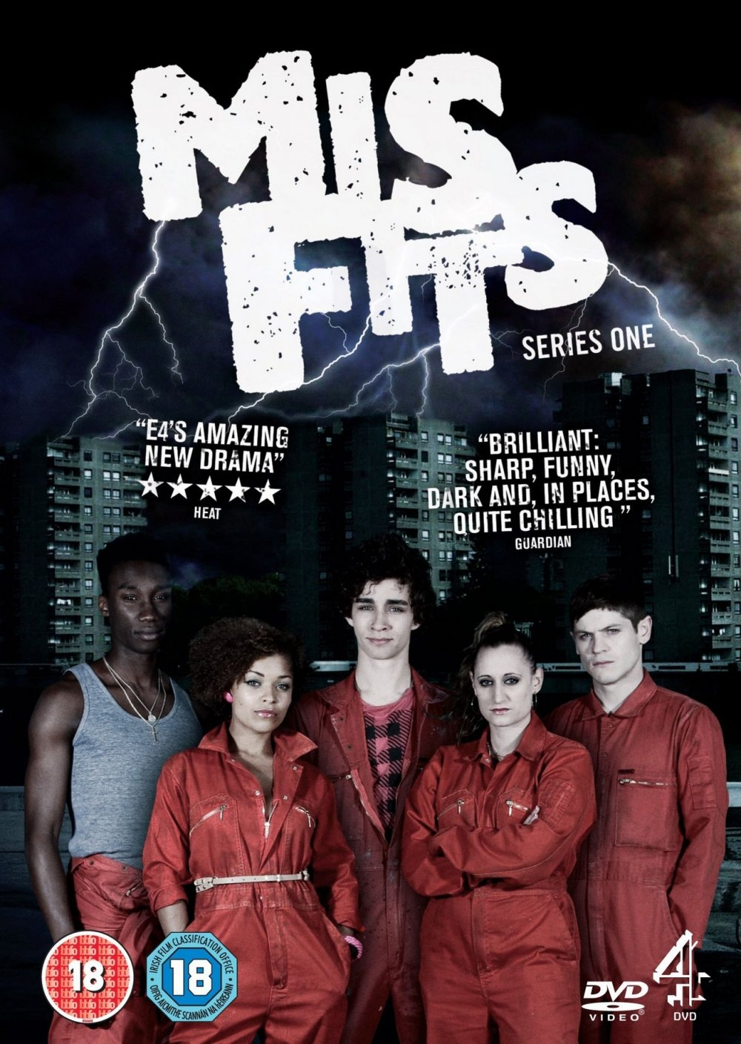
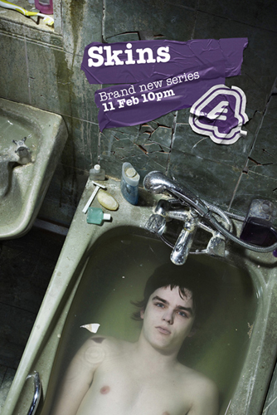
AO1: Demonstrate knowledge and understanding of media concepts, contexts and critical debates.
‘Troubled’ teens often come from a position of disadvantage: economically or educationally impoverished; a low class or ethnic minority background; a ‘broken’ home or culture of neglect; social isolation or awkwardness. How do UK TV shows fit this ideology?

Slide 11
AO1: Demonstrate knowledge and understanding of media concepts, contexts and critical debates.
Teenagers as ‘fun’
There is a whole media industry aimed at socially constructing youth in terms of lifestyle and identity. Magazines are produced specifically for young people. Record companies, Internet music download sites, mobile telephone companies and radio stations all specifically target and attempt to shape the musical tastes of young people. Networking sites on the Internet, such as Facebook, Twitter and Instagram, allow youth to project their identities around the world.

Slide 12
AO1: Demonstrate knowledge and understanding of media concepts, contexts and critical debates.
Why are teenagers represented positively?
What about this positive representation appeals to society’s dominant (hegemonic) ideology?
Teenagers have their own money to spend on their own interests. It makes sense to sell them positive representations to identify with, so they’ll spend their money on these aspirational items.
These positive representations could act as ‘role models’ to encourage teenagers to act in a more positive way.

Slide 13
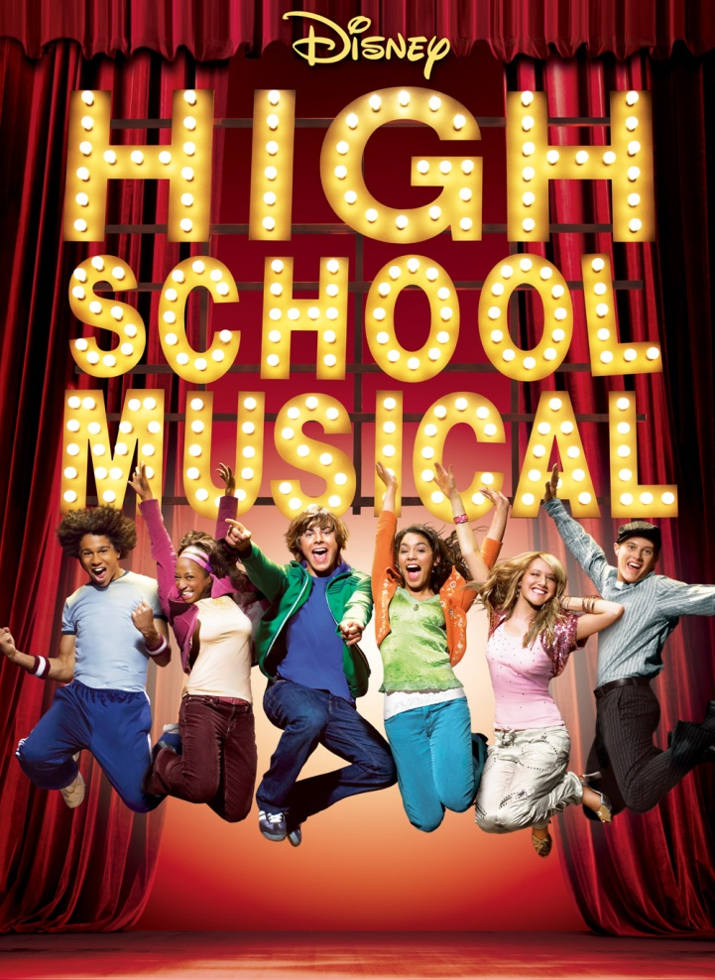
AO1: Demonstrate knowledge and understanding of media concepts, contexts and critical debates.
‘Fun’ teens are often popular, intelligent, fit conventional ideas of beauty, and have some sort of talent, overcoming any ethnic or economic disadvantage to celebrate diversity. How do Disney films fit this ideology? Can you think of any other examples?

Slide 14
AO1: Demonstrate knowledge and understanding of media concepts, contexts and critical debates.
Let’s look at some texts featuring teenagers. Make notes on your given text and be prepared to share your ideas with the class.
Does your text represent teenagers as ‘trouble’ or as ‘fun’ or as both? Is it a challenging or stereotypical representation?
Text 1: ‘Kidulthood’ trailer Text 2: ‘Boots’ advert
Text 3: ‘Misfits’ trailer Text 4: ‘Skins’ trailer
Text 5: ‘Scouting’ advert Text 6: ‘High School Musical’ trailer
Constructionist approach – a reminder:
The thing itself / the opinion of the encoder / reading and response of audience / context of society within which the representation takes place

Slide 15
AO1: Demonstrate knowledge and understanding of media concepts, contexts and critical debates.
Is there a difference between UK and US representations of teens?
Why might this be? How does it fit the dominant ideologies of those societies?
Homework:
Using the suggested texts (and any of your own), analyse the representations of teens in either the UK or the US media.
Bring your ideas to next lesson, ready to discuss whether there is a difference and, if so, why that difference exists.
US
90210
Glee
Gossip Girl
The OC
Smallville
Suburgatory
Teen Wolf
The Vampire Diaries
One Tree Hill
Suggested texts:
UK
Misfits
Skins
Inbetweeners
Kidulthood
Hollyoaks
Eastenders, Corrie etc.
Waterloo Road

