Slide 1
AO1: Demonstrate knowledge and understanding of media concepts, contexts and critical debates.
There’s one more group we haven’t thought about yet...
?
List the stereotypical qualities of a ‘child’ as represented in the media.

Slide 2
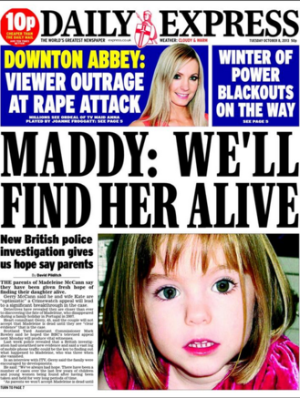
AO1: Demonstrate knowledge and understanding of media concepts, contexts and critical debates.
Focus on typical ideologies about children
British children are often depicted in the British media in positive ways. Content analyses of media products suggest that eight stereotypes of children are frequently used by the media.
As victims of horrendous crimes – some critics of the media have suggested that white children who are victims of crime get more media attention than adults or children from ethnic minority backgrounds.

Slide 3
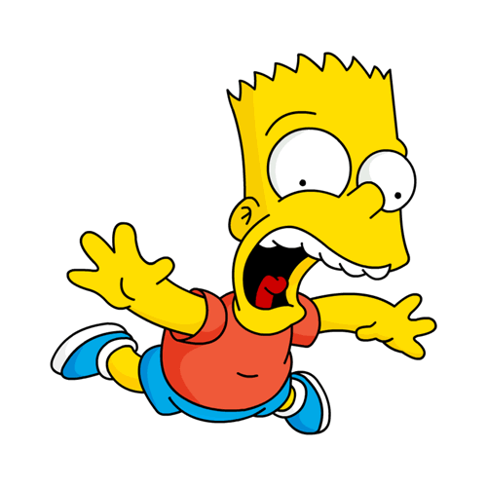
AO1: Demonstrate knowledge and understanding of media concepts, contexts and critical debates.
As cute – this is a common stereotype found in television commercials for baby products or toilet rolls.
As little devils – another common stereotype especially found in drama and comedy.

Slide 4
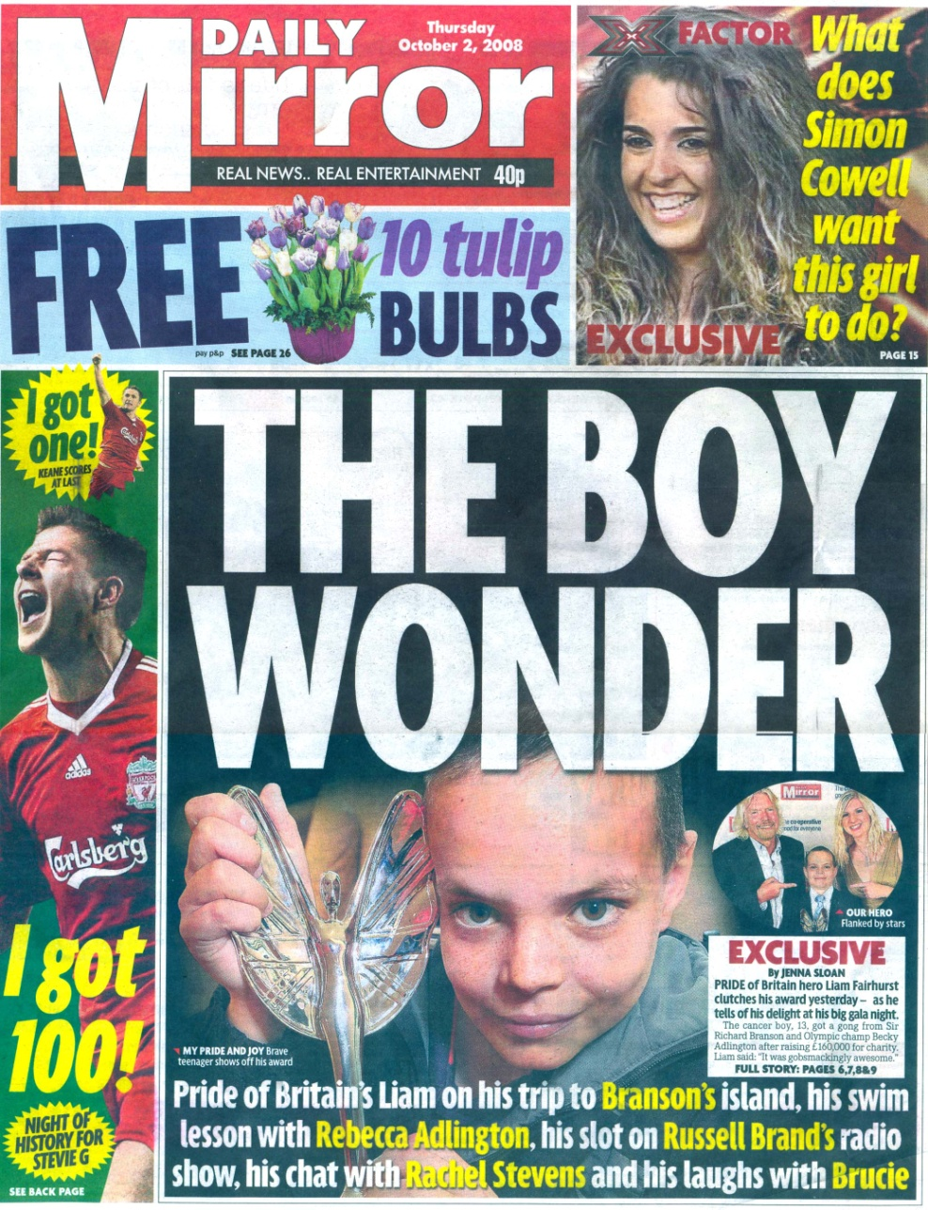
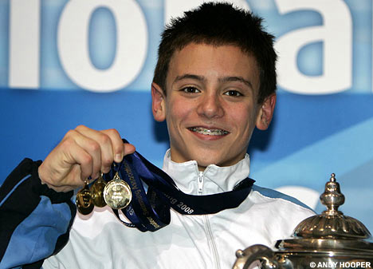
AO1: Demonstrate knowledge and understanding of media concepts, contexts and critical debates.
As brave little angels – suffering from a long-term terminal disease or disability.
As brilliant – perhaps as child prodigies or as heroes for saving the life of an adult.

Slide 5
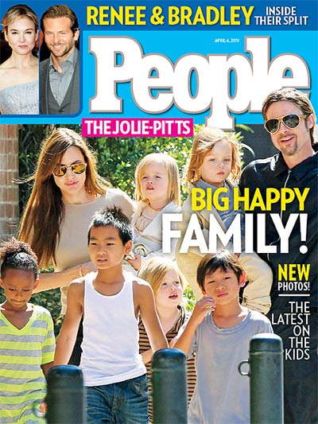
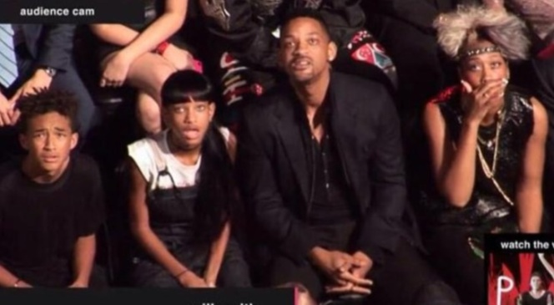
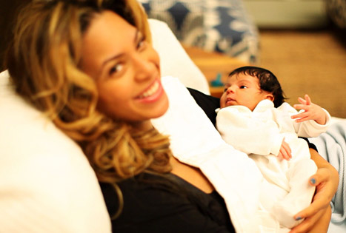
AO1: Demonstrate knowledge and understanding of media concepts, contexts and critical debates.
As accessories – stories about celebrities such as Madonna, Angelina Jolie or the Beckhams may focus on how their children humanise them.

Slide 6
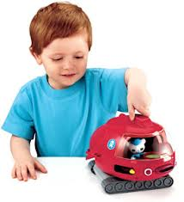
AO1: Demonstrate knowledge and understanding of media concepts, contexts and critical debates.
As modern – the media may focus on how children ‘these days’ know so much more ‘at their age’ than previous generations of children.
As active consumers – television commercials portray children as having a consumer appetite for toys and games. Some family sociologists note that this has led to the emergence of a new family pressure, ‘pester power’, the power of children to train or manipulate their parents to spend money on consumer goods that will increase the children’s status in the eyes of their peers.

Slide 7
AO1: Demonstrate knowledge and understanding of media concepts, contexts and critical debates. AO2: Apply knowledge and understanding when analysing media products and processes, to show how meanings and responses are created.
Let’s look at some adverts featuring children. Make notes on your given advert and be prepared to share your ideas with the class.
(How) does your advert feature these typical representations?
Text 1: Evian advert Text 2: IKEA ‘Playing with my friends’ advert
Text 3: Cancer Research UK advert Text 4: John Lewis Christmas advert (2011)
Constructionist approach – a reminder:
The thing itself / the opinion of the encoder / reading and response of audience / context of society within which the representation takes place

Slide 8
AO1: Demonstrate knowledge and understanding of media concepts, contexts and critical debates.
children/ teenagers/ the elderly

Slide 9
AO1: Demonstrate knowledge and understanding of media concepts, contexts and critical debates.

