Slide 1
Representations of an Event
Celebrity Death

Slide 2
With reference to your own detailed examples, explore the representation of events in the media today.
The news media is central to the representation of events. The news is information about an event which is communicated to an audience. For an event to be ‘newsworthy’ it must be of importance and relevance to the target audience. Media news is a construction like any other media text.
Terminology revision:
Primary definer: someone who has first-hand knowledge of the event, e.g. an eye witness, journalist or emergency services. This includes information from Twitter, YouTube etc.
Secondary definer: usually the news agencies or journalists who construct a story out of the event. They do this to meet the needs of their target audience.

Slide 3
In order to consider why an event is newsworthy and how it is represented, you need to use your knowledge of news values. News values are what makes a story important and decide how it is constructed and prioritised.
News Values | Description
The power elite | Stories involving powerful people or organisations
Celebrity | Famous people
Entertainment | Stories that feature human interest, sex scandals, show business or animals; opportunities for humour, photographs, headlines etc.
Surprise | Stories which contain an element of unexpectedness or which contrast with other stories which are currently in the public sphere
Bad news | The majority of news tends to be bad news as this is what is judged to attract audiences and engage their interest
Good news | Heroic rescues or cures for illnesses etc.
Magnitude | The size of an event in terms of the number of people affected or potential for impact
Relevance | Stories featuring issues, social groups of countries that are seen to be relevant to the target audience
Follow-ups | Continuation of stories that have already been in the news and have engaged public interest
Media agenda | Stories which fit in with the producer’s own agenda on a range of issues, especially its stance on politics, social affairs and culture

Slide 4
We can use news values to develop an understanding of why certain events are represented in the news and how they are represented. News values are applied in the selection and construction of stories, in order to suit the purpose of the media text and its target audience, e.g. a local paper will have a different news agenda than a national paper; the popular press (tabloids, appealing to a mass audience) will place more emphasis on celebrity and entertainment than the quality press (broadsheets, often more focused on politics and foreign affairs).
How have the deaths of David Bowie and Prince been represented in the media?

Slide 5
Watch the BBC news article on the death of Prince and fill in the tables on your sheet.
News Values | Description
The power elite
Celebrity
Entertainment
Surprise
Bad news
Good news
Magnitude
Relevance
Follow-ups
Media agenda
Representations:
‘Star’/talent /legacy
Shock value vs ‘ill health’
Part of a wider context
Privacy
References to size
‘Darker side’ – ‘sexy’; ‘vivacious’
Sense of an ongoing narrative

Slide 6
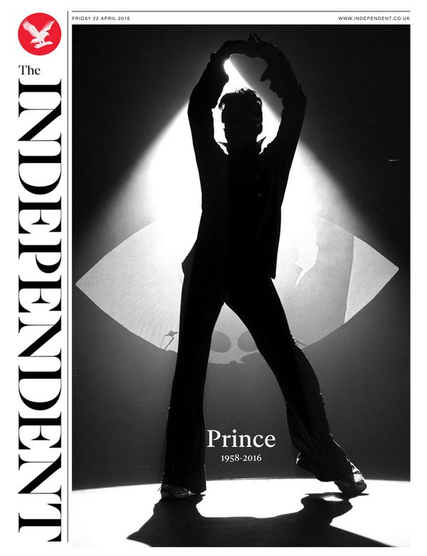
How has this representation been selected, constructed and anchored? Why has it been created in this way/how is it being used? Is this a typical representation in this context? What issues and debates surround this representation?

Slide 7
Textual Analysis and News Values:
Why does the story take up the whole of the front page?
What is the impact of the image?
What representation of Prince is created? Why?
How does the text anchor the image?
What news values are present?
How is the audience positioned?
What uses and gratifications are present?

Slide 8
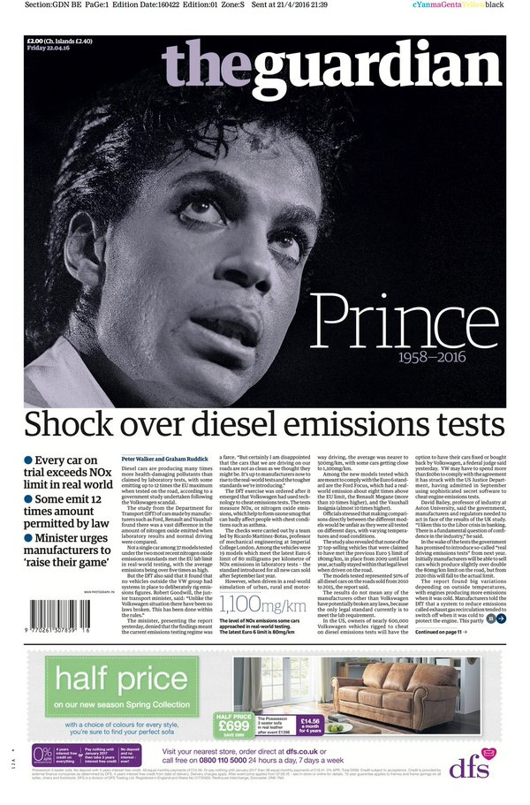
Textual Analysis and News Values:
Why does the story take up half of the front page?
What is so important about the rest of the front page news?
What is the impact of the image?
What representation of Prince is created? Why?
How does the text anchor the image?
What news values are present?
How is the audience positioned?
What uses and gratifications are present?

Slide 9
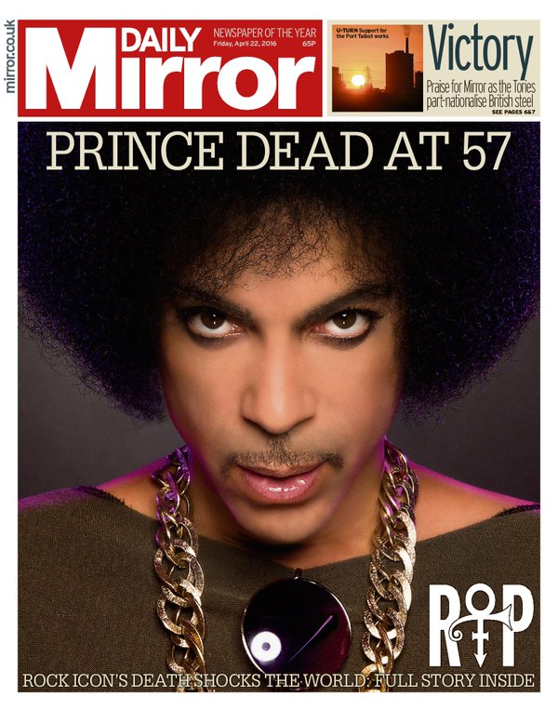
Textual Analysis and News Values:
Why does the story take up most of the front page?
What is so important about the rest of the front page news?
What is the impact of the image?
What representation of Prince is created? Why?
How does the text anchor the image?
What news values are present?
How is the audience positioned?
What uses and gratifications are present?

Slide 10
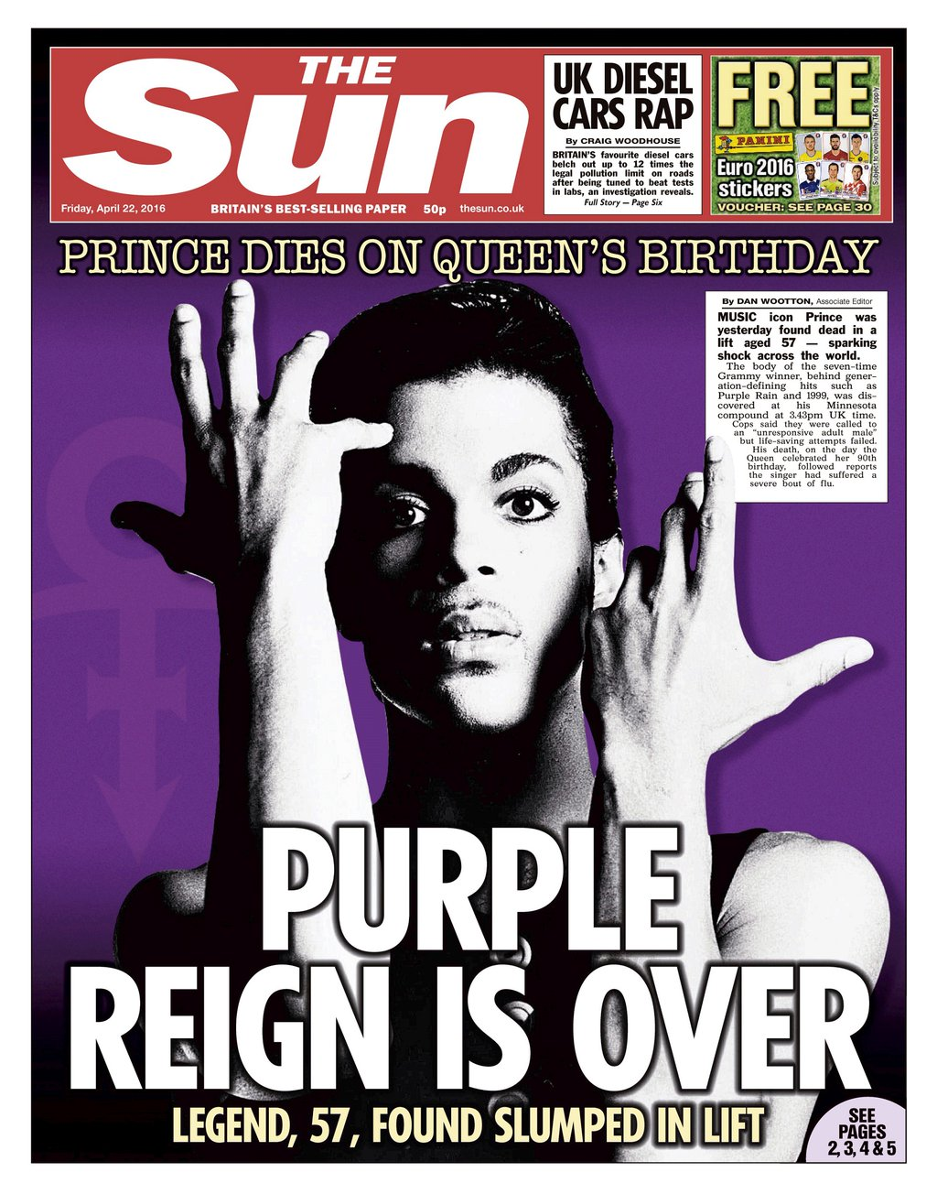
Textual Analysis and News Values:
Why does the story take up most of the front page?
What is so important about the rest of the front page news?
What is the impact of the image?
What representation of Prince is created? Why?
How does the text anchor the image?
What news values are present?
How is the audience positioned?
What uses and gratifications are present?

Slide 11
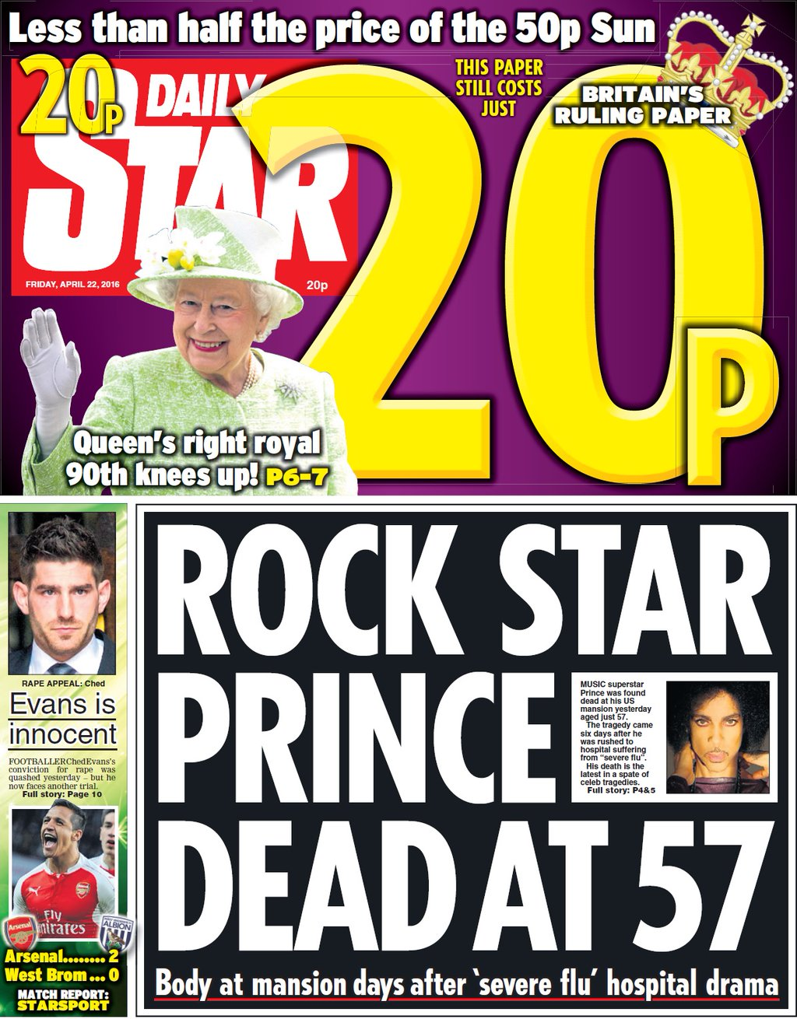
Textual Analysis and News Values:
Why does the story take up a third of the front page?
What is so important about the rest of the front page news?
What is the impact of the image?
What representation of Prince is created? Why?
How does the text anchor the image?
What news values are present?
How is the audience positioned?
What uses and gratifications are present?

Slide 12
How has this representation been selected, constructed and anchored? Why has it been created in this way/how is it being used? Is this a typical representation in this context? What issues and debates surround this representation?

Slide 13
Do tabloids and broadsheets have different news values?

Slide 14
How would you summarise the representation of this event?

Slide 15
Do all celebrity deaths get represented in this way?

Slide 16
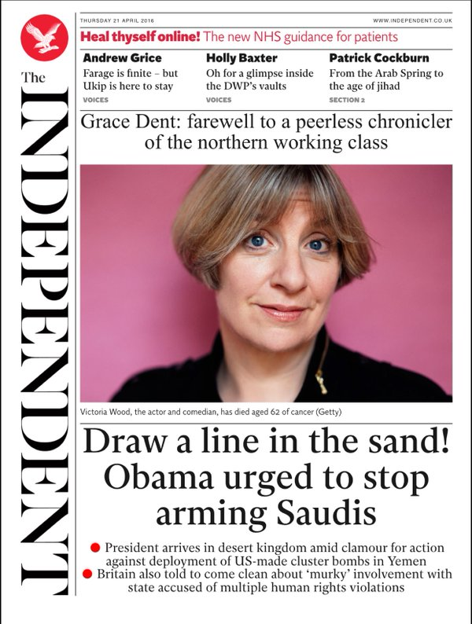
Textual Analysis and News Values:
Positioning
Context (including other news)
Image choice
Text/anchorage
News values
Audience positioning
U+G

Slide 17
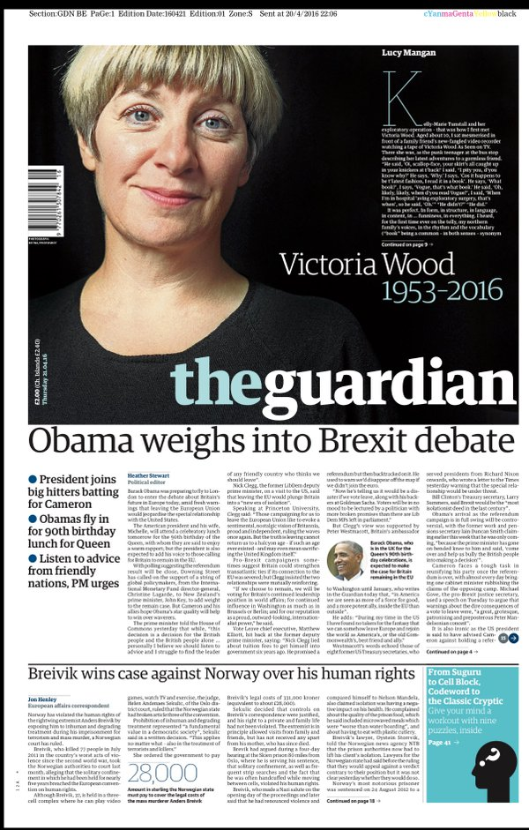
Textual Analysis and News Values:
Positioning
Context (including other news)
Image choice
Text/anchorage
News values
Audience positioning
U+G

Slide 18
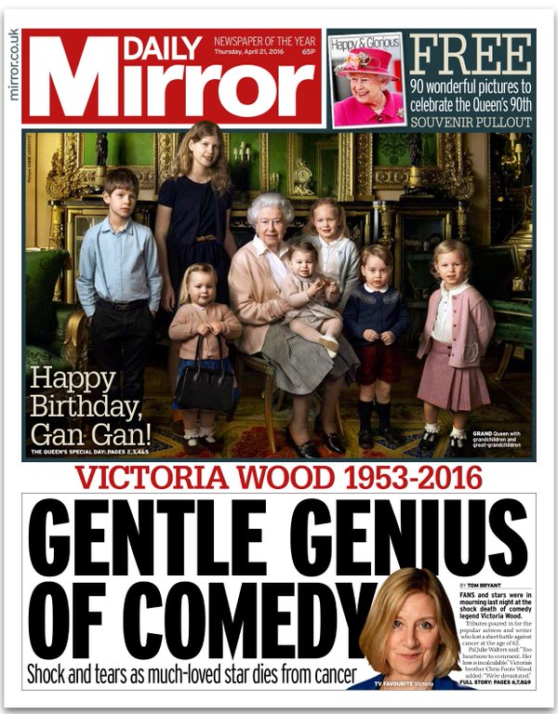
Textual Analysis and News Values:
Positioning
Context (including other news)
Image choice
Text/anchorage
News values
Audience positioning
U+G

Slide 19
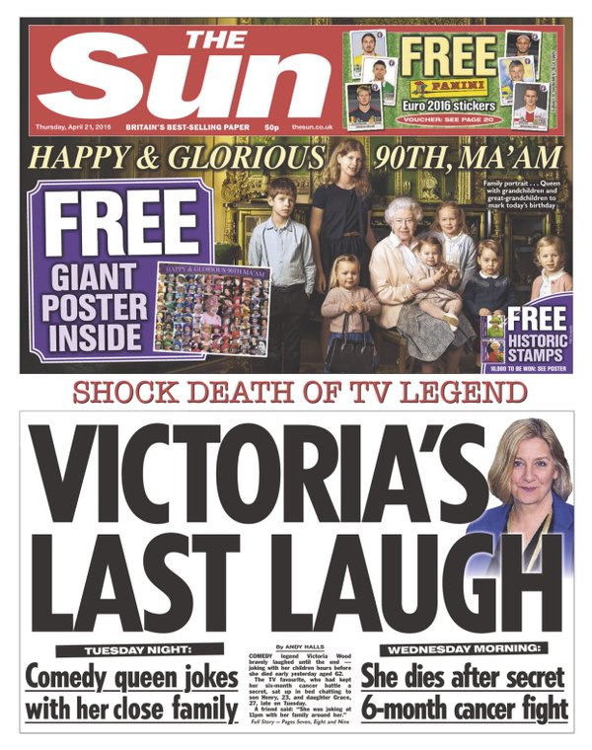
Textual Analysis and News Values:
Positioning
Context (including other news)
Image choice
Text/anchorage
News values
Audience positioning
U+G

Slide 20
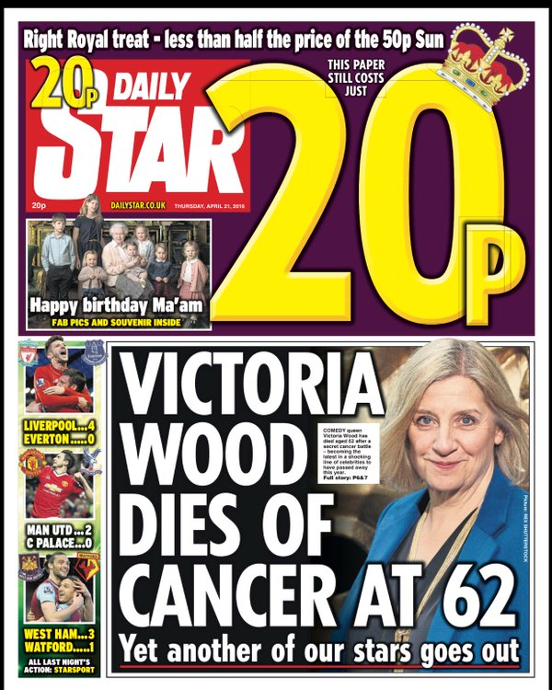
Textual Analysis and News Values:
Positioning
Context (including other news)
Image choice
Text/anchorage
News values
Audience positioning
U+G

Slide 21
Is this event represented differently than Prince’s death?

Slide 22
How would you summarise the representation of this event?

Slide 23
Watch the BBC news article on the death of David Bowie – what news values are present?
News Values | Description
The power elite
Celebrity
Entertainment
Surprise
Bad news
Good news
Magnitude
Relevance
Follow-ups
Media agenda

Slide 24
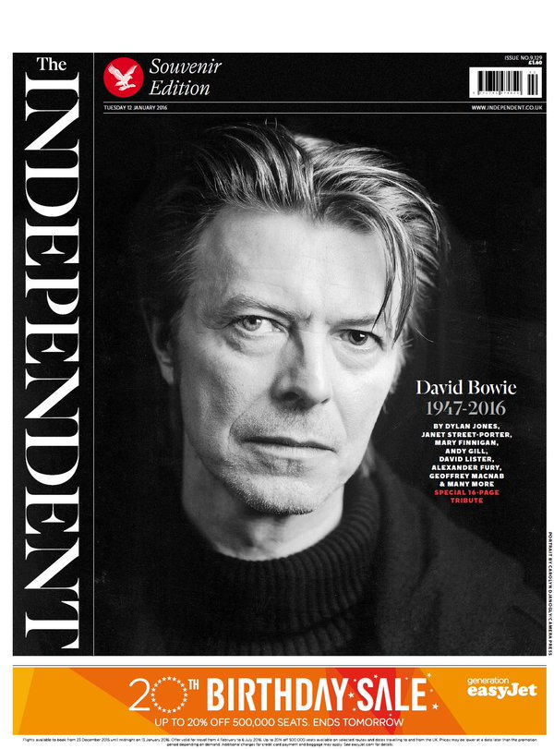
Textual Analysis and News Values:
Positioning
Context (including other news)
Image choice
Text/anchorage
News values
Audience positioning
U+G

Slide 25
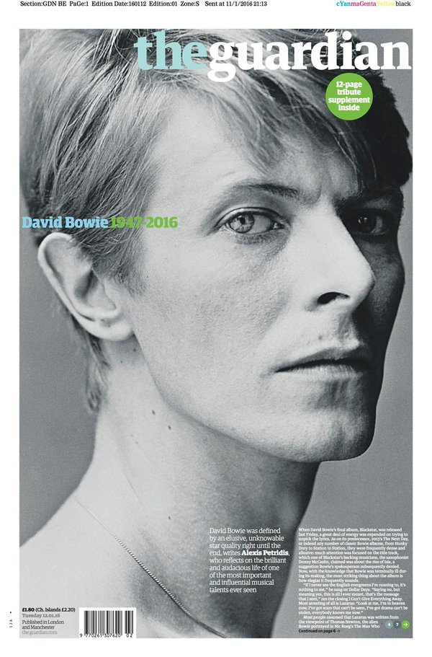
Textual Analysis and News Values:
Positioning
Context (including other news)
Image choice
Text/anchorage
News values
Audience positioning
U+G

Slide 26
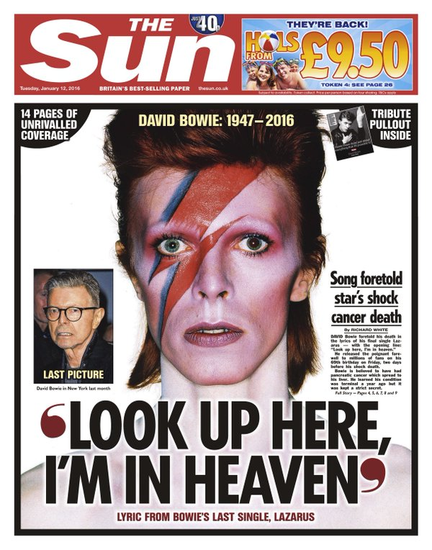
Textual Analysis and News Values:
Positioning
Context (including other news)
Image choice
Text/anchorage
News values
Audience positioning
U+G

Slide 27
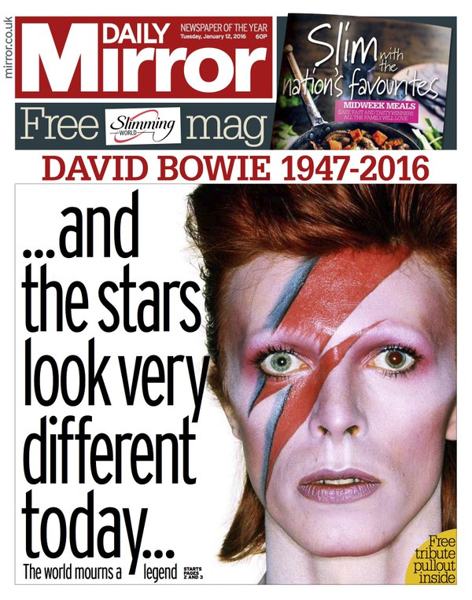
Textual Analysis and News Values:
Positioning
Context (including other news)
Image choice
Text/anchorage
News values
Audience positioning
U+G

Slide 28
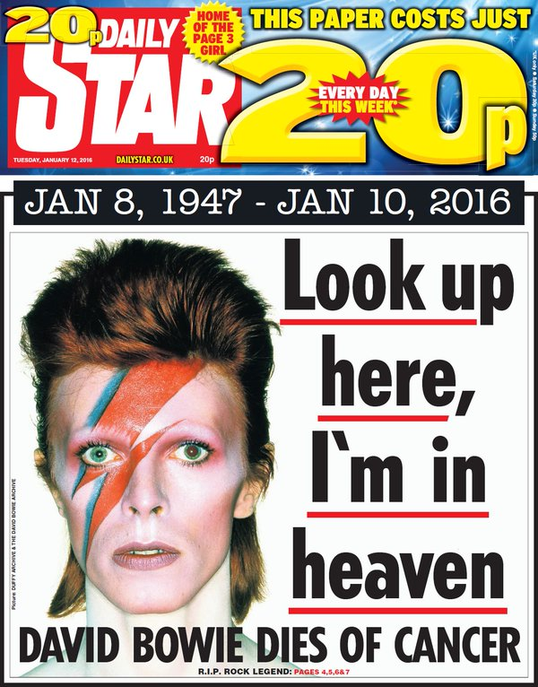
Textual Analysis and News Values:
Positioning
Context (including other news)
Image choice
Text/anchorage
News values
Audience positioning
U+G

Slide 29
Is this event represented differently to Prince’s death? To Victoria Wood’s death?

Slide 30
Do the broadsheet and tabloid representations differ? Why?

Slide 31
How would you summarise the representation of this event?

Slide 32
With reference to your own detailed examples, explore the representation of events in the media today.
Refer to 2-3 events.
Write about different ways they are represented.
Using the constructionist view of representation, answer the following questions:
How has this representation been selected, constructed and anchored?
Why has it been created in this way/how is it being used?
Is this a typical representation in this context?
What issues and debates surround this representation?
Include a minimum of three different key texts for each event. Try to include an audio-visual text as well as print based.

