Slide 1
AO1: Demonstrate knowledge and understanding of media concepts, contexts and critical debates. AO2: Apply knowledge and understanding when analysing media products and processes, to show how meanings and responses are created.
What conclusions can we reach about the ways men and women are represented in the media?
Write an A-Z of gender representation.
Appearance
Behaviour
Relationships
Role/ function
Equilibrium/ disequilibrium
Ideology
Audience readings and responses
Queer Theory
Constructionist approach – a reminder:
The thing itself / the opinion of the encoder / reading and response of audience / context of society within which the representation takes place

Slide 2
AO1: Demonstrate knowledge and understanding of media concepts, contexts and critical debates.
Focus on advertising
Adverts are aimed at a gendered audience, telling us what it means to be a man or a woman. They use gender stereotypes intentionally as a short-hand.

Slide 3
AO1: Demonstrate knowledge and understanding of media concepts, contexts and critical debates.

Slide 4
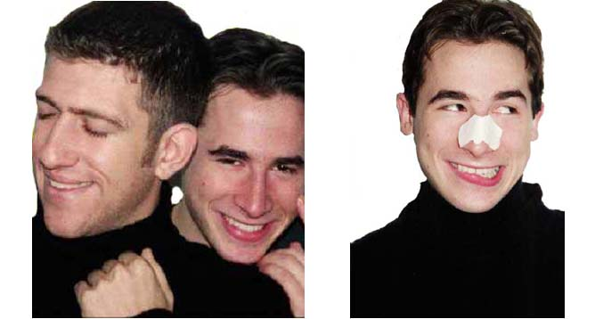
AO1: Demonstrate knowledge and understanding of media concepts, contexts and critical debates.
Notes:
Why should it seem funny to see a picture of adult men striking a pose when the same pose seems normal or charming to us in pictures of adult women?

Slide 5
AO1: Demonstrate knowledge and understanding of media concepts, contexts and critical debates.

Slide 6
AO1: Demonstrate knowledge and understanding of media concepts, contexts and critical debates.

Slide 7
AO1: Demonstrate knowledge and understanding of media concepts, contexts and critical debates.
It's not based in actual behaviour. In ordinary life, neither adult men nor adult women commonly strike poses like those we see regularly in fashion magazines.

Slide 8
AO1: Demonstrate knowledge and understanding of media concepts, contexts and critical debates.
Yet for some reason it seems normal to display pictures of women striking poses that would seem funny or strange when struck by men. Erving Goffman's study called “Gender Advertisements” is useful here because he focused on, among other things, poses common to magazine advertisements. "Commercial photographs," Goffman points out, "involve carefully performed poses presented in the style of being 'only natural'." (84)

Slide 9
Are these poses more natural for one gender over another? Are they natural at all?

Slide 10
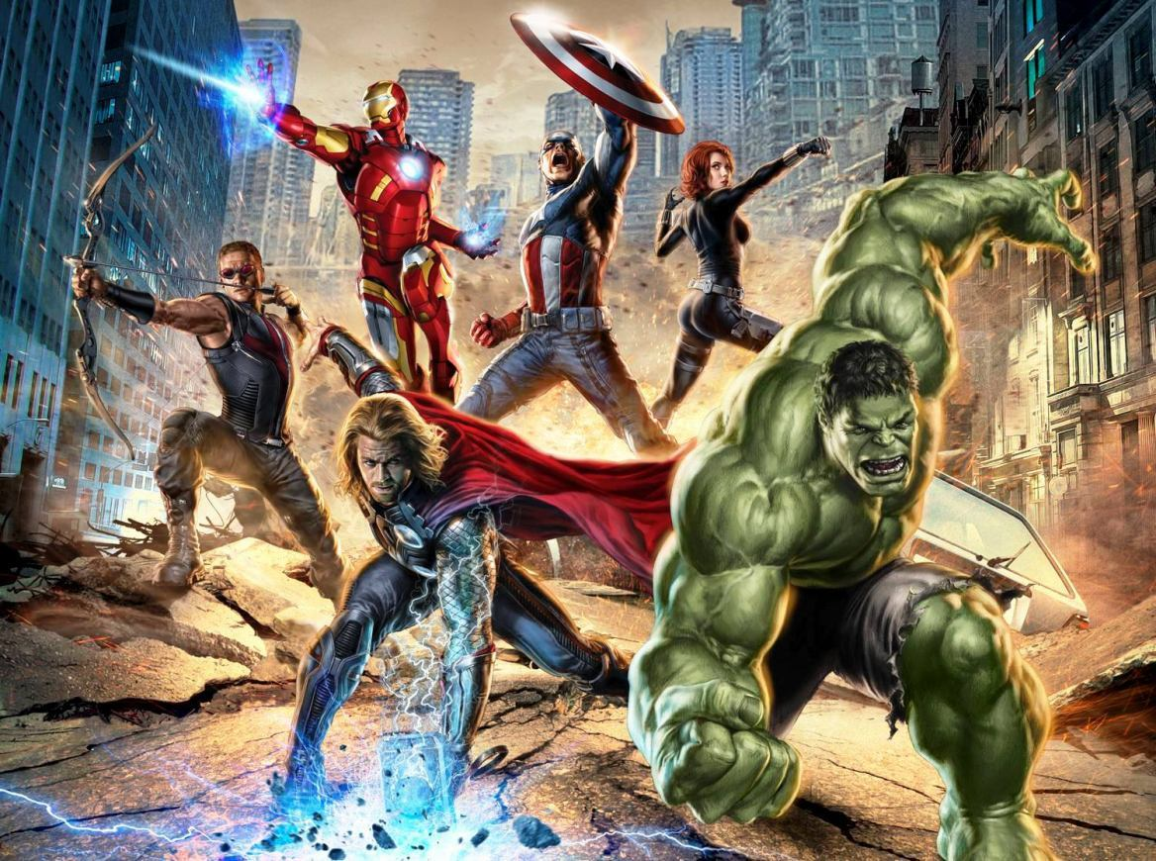

Slide 11
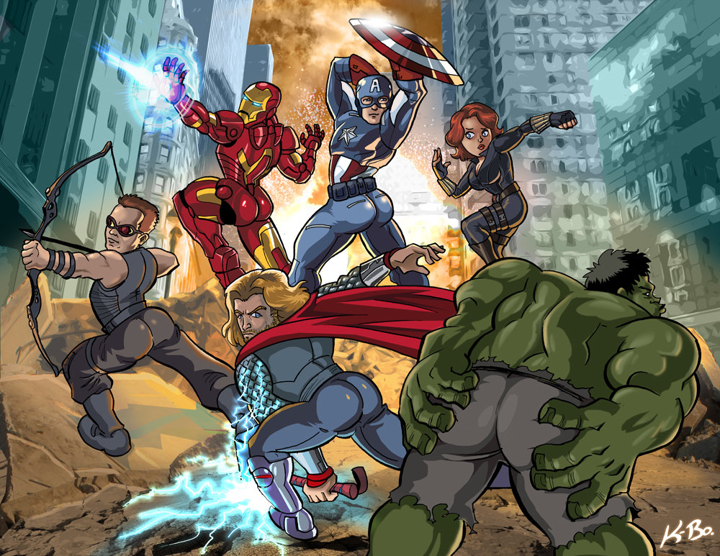

Slide 12
How natural do these poses seem now?

Slide 13
AO1: Demonstrate knowledge and understanding of media concepts, contexts and critical debates.
According to Kilbourne, women are more often shown “dismembered” (just parts of their bodies shown), associated with products, shown as smaller than a man, engaged in various forms of ritualized subordination, prostrate or recumbent, bent or leaning back, infantilized (with finger coyly in their mouth, standing pigeon-toed, wearing little girl clothes, sucking on lollipops, etc.), looking dreamy and introverted, overcome with emotions, or symbolically silenced with hand over the mouth.

Slide 14
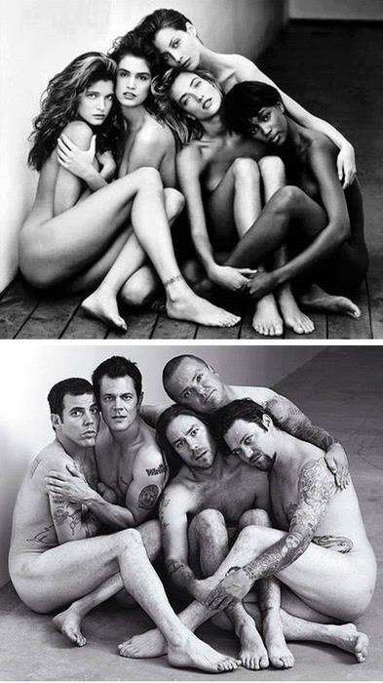
AO1: Demonstrate knowledge and understanding of media concepts, contexts and critical debates.
Why does it strike us as odd, bizarre or humorous when roles are reversed?
What does this tell us about the cultural construction of gender – of the qualities are associated with images of masculinity and femininity and the accepted boundaries between them?

Slide 15
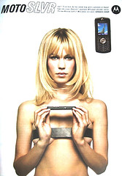
Gender Representations in Advertising
Goffman’s Theory (1972)
Goffman argues that there are codes which can be used to identify gender. These codes of gender can be seen in the portrayals of men and women in advertising.
Superiority, Domination & Body Language: Men are shown in dominant positions and appear to be reflective of thought and intelligence. Women are physically portrayed in sexual or reclining poses with blank or inviting expressions.
Dismemberment: On females, parts of the body such as legs, chest, etc., are used, rather than the full body. This is often applied to sell products which are not related to the body, such as mobile phones (right)
The Voice-Over Authority: In moving image advertisements, male voices are used as voice-overs in commercials rather than females.

Slide 16
?

Slide 17
?

Slide 18
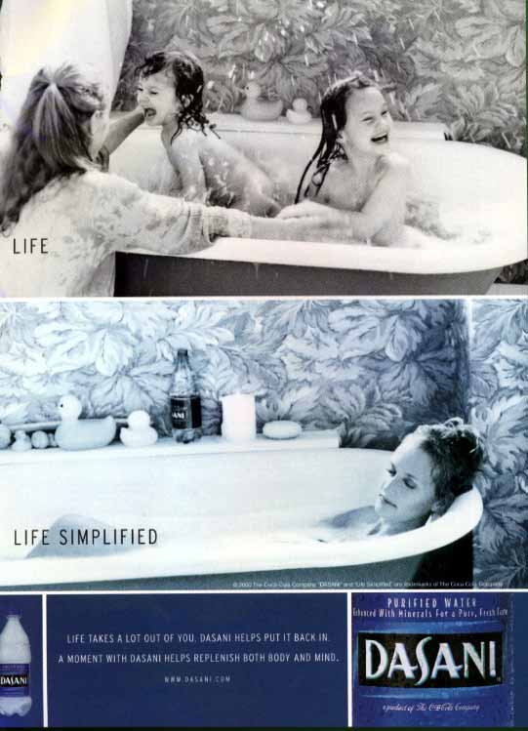
?

Slide 19
?

Slide 20
?

Slide 21
AO1: Demonstrate knowledge and understanding of media concepts, contexts and critical debates. AO2: Apply knowledge and understanding when analysing media products and processes, to show how meanings and responses are created.
Homework: Find an advert (moving image or print-based) that features one of Goffman’s codes in its representation of gender.
Superiority, Domination & Body Language: Men are shown in dominant positions and appear to be reflective of thought and intelligence. Women are physically portrayed in sexual or reclining poses with blank or inviting expressions.
Dismemberment: On females, parts of the body such as legs, chest, etc., are used, rather than the full body. This is often applied to sell products which are not related to the body.
The Voice-Over Authority: In moving image advertisements, male voices are used as voice-overs in commercials rather than females.
Write a short analysis (500 words max) on your chosen advert, exploring how it reinforces or challenges typical gender roles. Use Goffman’s codes and apply a theoretical viewpoint if you can.

Slide 22
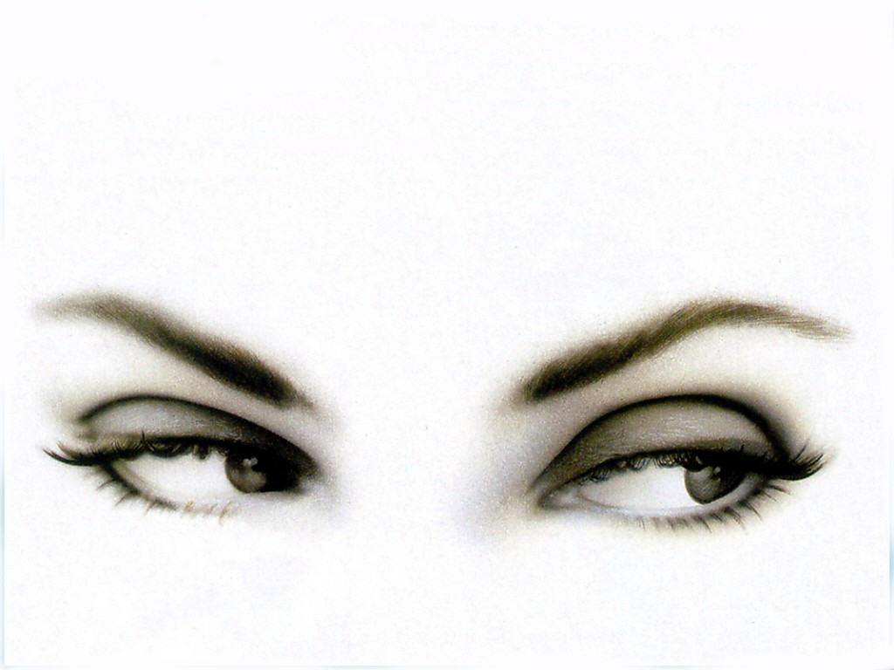
AO1: Demonstrate knowledge and understanding of media concepts, contexts and critical debates.
Laura Mulvey, objectification and ‘the gaze’.
The concept of ‘gaze’ is one that deals with how an audience views the people presented.
When considering gender representation, the main concerns are:
how men look at women
how women look at themselves
how women look at other women

Slide 23
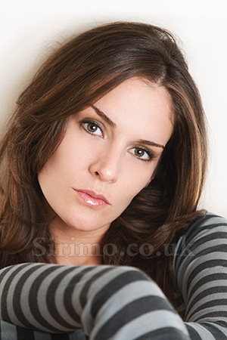
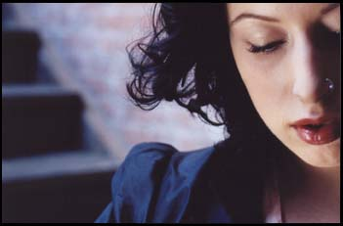
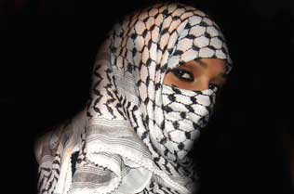
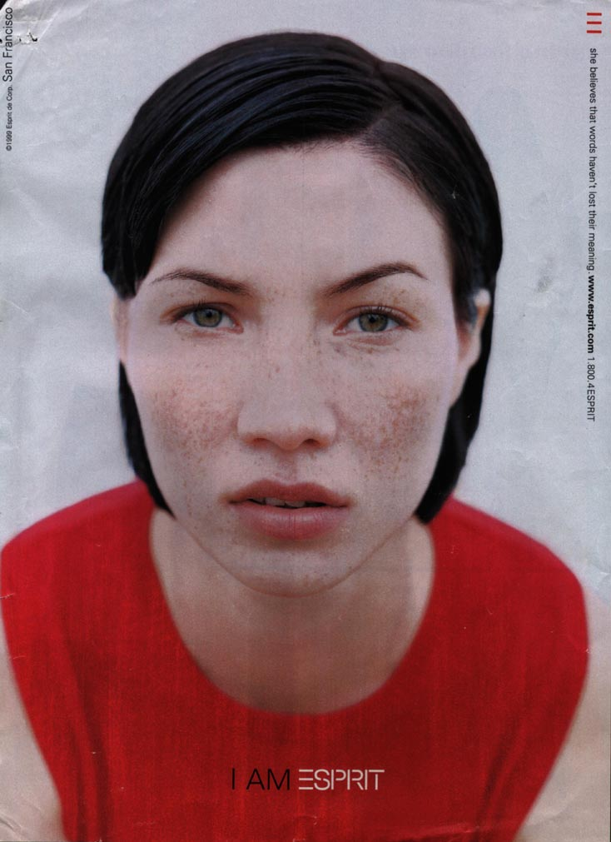
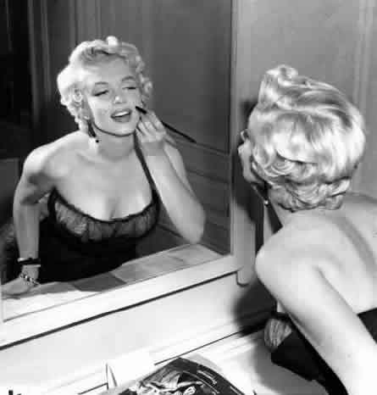
Thinking about what we’ve just found out, what are the connotations of ‘the gaze’ of these women?

Slide 24
AO1: Demonstrate knowledge and understanding of media concepts, contexts and critical debates.
Laura Mulvey is a British feminist film theorist. In her 1973 essay Visual Pleasure and Narrative Cinema she argued that classic Hollywood cinema puts the spectator in a masculine position, with the figure of the woman on screen as the object of desire.
Because the viewer is gendered as male (even if she’s a woman!) the woman on the screen is ‘controlled’ and made an ‘object’ of male desire.
Let’s explore this a little further… *(constructed by the gaze)

Slide 25
Why is the audience ‘male’?
AO1: Demonstrate knowledge and understanding of media concepts, contexts and critical debates.
"In a world ordered by sexual imbalance, pleasure in looking has been split between active/male and passive/female"
1. Historic power roles: directors tend to be male, thus presenting a ‘male’ representation of their subject. Therefore, even if you’re a woman, you’re seeing the world of the film through a man’s eyes.
2. Viewers are encouraged to identify with the protagonist of the film who, more often than not, is a man. Therefore, even if you’re a woman, you’re identifying with a man’s view of the cinematic world.
In both these examples, the ‘male’ is active (the one doing the looking) and the ‘female’ is passive (the one being looked at). Male characters may also be looked at, but it is still a male viewpoint.

Slide 26
Mulvey’s Argument
AO1: Demonstrate knowledge and understanding of media concepts, contexts and critical debates.
In “Visual Pleasure and Narrative Cinema” Laura Mulvey argues for the concept of a “male gaze”. The audience is required to see the action and characters of a text through the perspective of a heterosexual man; the camera lingers on the curves of the female body, and events which occur to women are presented largely in the context of a man's reaction to these events. Mulvey argues that the male gaze relegates women to the status of objects. The female viewer experiences the text secondarily, by identification with the male.

Slide 27
AO1: Demonstrate knowledge and understanding of media concepts, contexts and critical debates.
“The determining male gaze projects its fantasy on to the female figure which is styled accordingly. In their traditional exhibitionist role women are simultaneously looked at and displayed, with their appearance coded for strong visual and erotic impact so that they can be said to connote to-be-looked-at-ness.
-- Laura Mulvey
The camera lingers on the female body; events which occur to women are presented in the context of men’s reactions to them; the viewer identifies with the male.

Slide 28
In other words...
AO1: Demonstrate knowledge and understanding of media concepts, contexts and critical debates.
Women are objectified for male viewing pleasure
In films, they have little to do with the progression of the plot but actually slow it down as the viewer pauses to look at them
Events which occur to women on screen are presented largely in the context of a man’s reaction to these events

Slide 29
AO1: Demonstrate knowledge and understanding of media concepts, contexts and critical debates.
“I love the way she fills her clothes. She looks just like them girls in Vogue.” – Scouting for Girls, ‘She’s so Lovely’.
Watch the video then get ready for some questions...

Slide 30
AO1: Demonstrate knowledge and understanding of media concepts, contexts and critical debates.
What colour top was she wearing? Was he wearing?
Which bowling lane was used?
What colour belt did she wear? Did he wear?
What colour shoes did she have? Did he have?
What colour eyes did she have? Did he have?
Could you answer all the questions?
Possible reason why not: you were too busy looking at the woman!

Slide 31
AO1: Demonstrate knowledge and understanding of media concepts, contexts and critical debates.
Look at the images you have been given.
1) How is the gaze of the audience gendered?
2) How is the audience positioned in relation to the female figure in the image?
3) What representation of the women in the images is present?

Slide 32
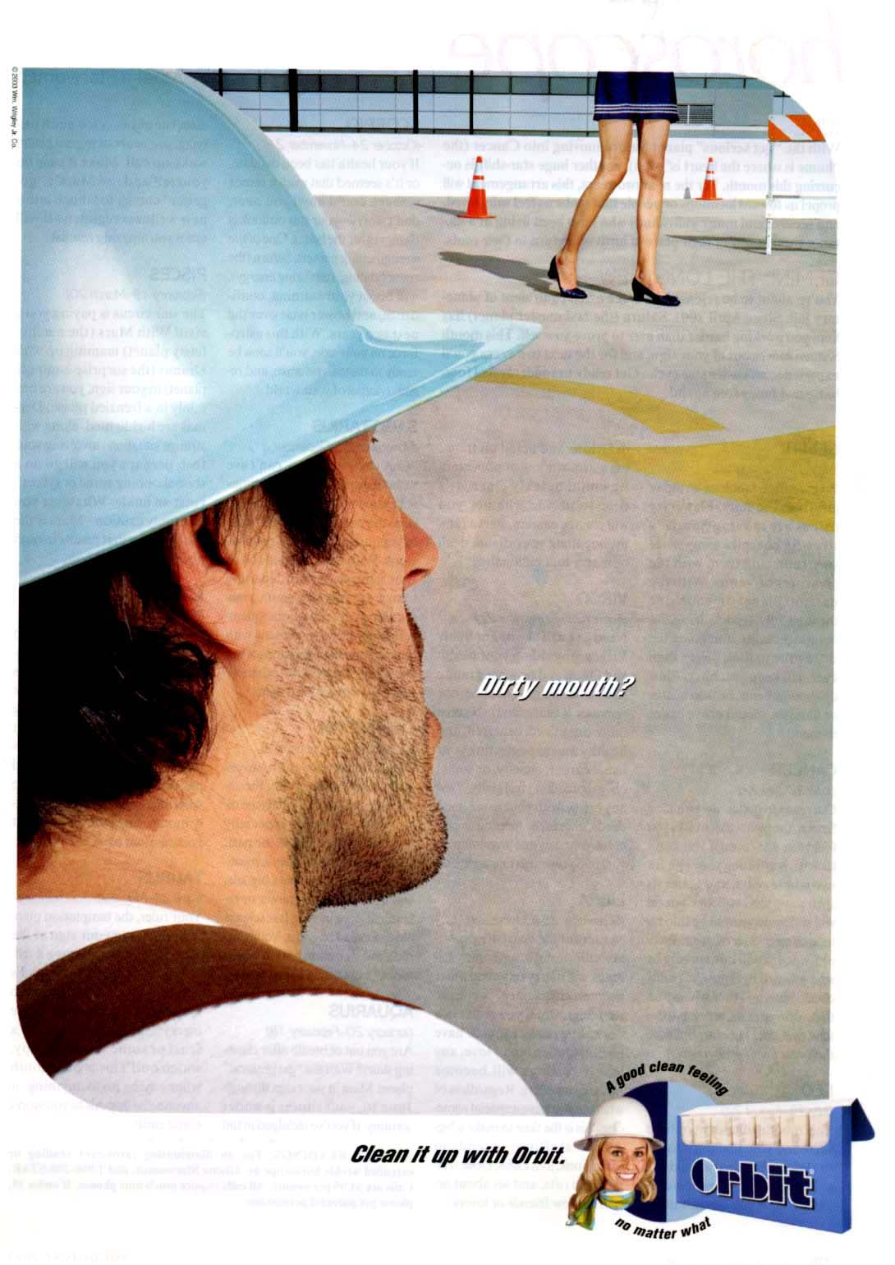
AO2: Apply knowledge and understanding when analysing media products and processes, to show how meanings and responses are created.

Slide 33
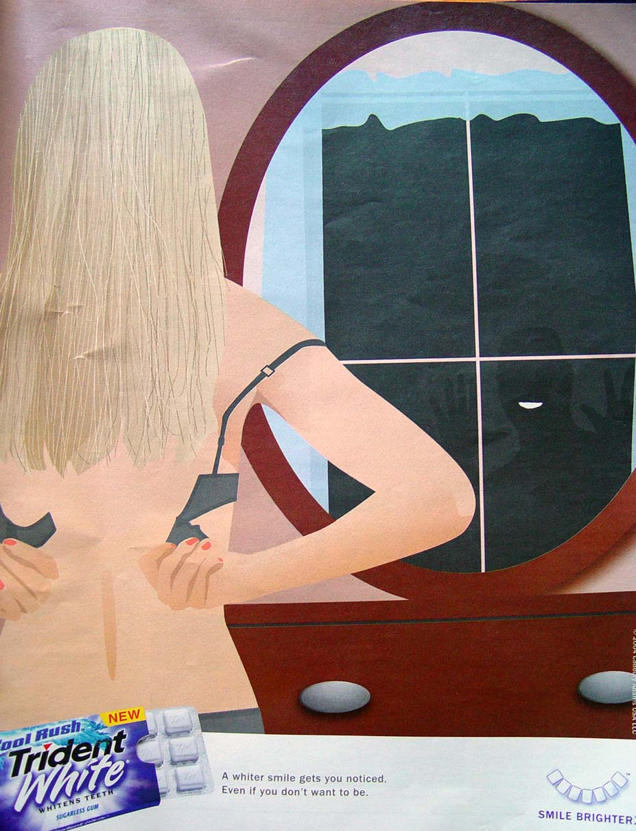
AO2: Apply knowledge and understanding when analysing media products and processes, to show how meanings and responses are created.
Notes:
“A WHITER SMILE GETS YOU NOTICED EVEN IF YOU DON’T WANT TO BE”

Slide 34
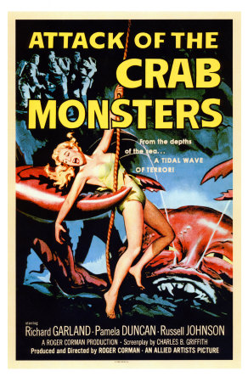
AO2: Apply knowledge and understanding when analysing media products and processes, to show how meanings and responses are created.
Notes:
HORROR movie posters in the 1950s regularly focus on a scene of attack, with a woman in peril. The posters put the viewers in the position where they are asked to take action and to imagine themselves doing something to save the woman. THE main scene in each poster spills over the edge of the poster, making it seem as if we, the audience, are there in the frame – we are incited to act. For example, in the creature from black lagoon poster, the rescuers are far away – “we” are closer. Conversely, women always are always victims and powerless. If they have any power, this is demonized.

Slide 35
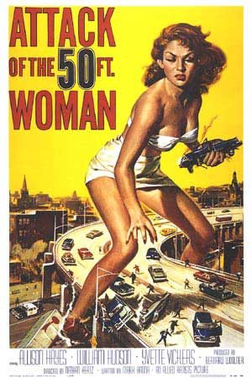
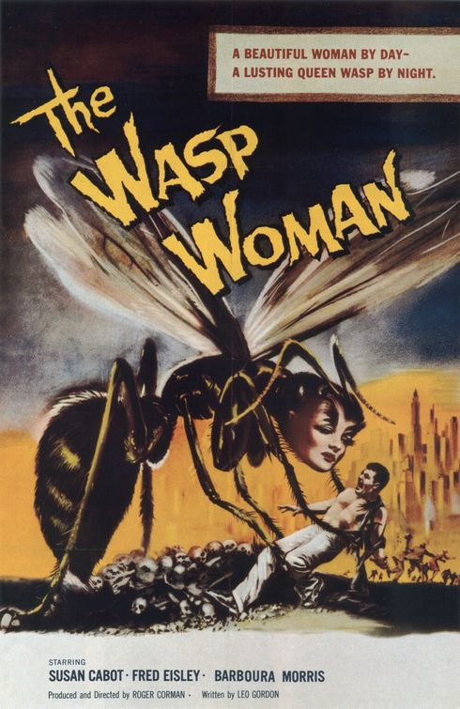
AO2: Apply knowledge and understanding when analysing media products and processes, to show how meanings and responses are created.

Slide 36
AO1: Demonstrate knowledge and understanding of media concepts, contexts and critical debates.
HORROR movie posters in the 1950s regularly focus on a scene of attack, with a woman in peril. The posters put the viewers in the position where they are asked to take action and to imagine themselves doing something to save the woman. The main scene in each poster spills over the edge of the poster, making it seem as if we, the audience, are there in the frame – we are incited to act. For example, in the creature from black lagoon poster, the rescuers are far away – “we” are closer. Conversely, women always are always victims and powerless. If they have any power, this is demonized.
Has anything changed?

Slide 37
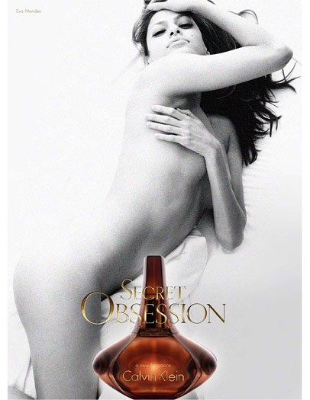
These adverts are aimed at a female audience. How is their gaze gendered?

Slide 38
So what about the female gaze?
AO1: Demonstrate knowledge and understanding of media concepts, contexts and critical debates.
Mulvey believes that women take on the male gaze because they view media from the perspective of men – they then view other women the way men would and objectify them in the same way.
She thinks that the female gaze is negated, or ‘drowned out’ by the dominant male gaze.

Slide 39
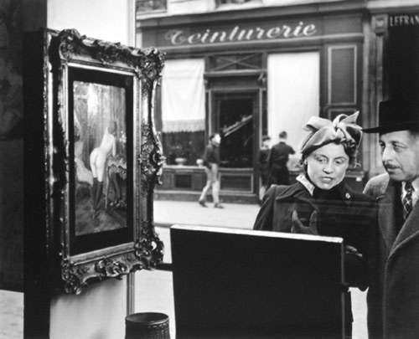
This photograph exemplifies Mulvey’s ideas about the classic treatment of the ‘female gaze’
We can’t see what the woman is looking at (so it’s not the focus of the photograph)
She and the object of her gaze are framed by the man and by what he is looking at – the painting of a nude woman
We follow the gaze of the man and look at what he’s looking at, identifying with him; we see what he sees
Both women are ‘passive’; the man is ‘active’
The female gaze is ‘negated’ and she is thus ‘controlled’
The dominant gaze is masculine

Slide 40
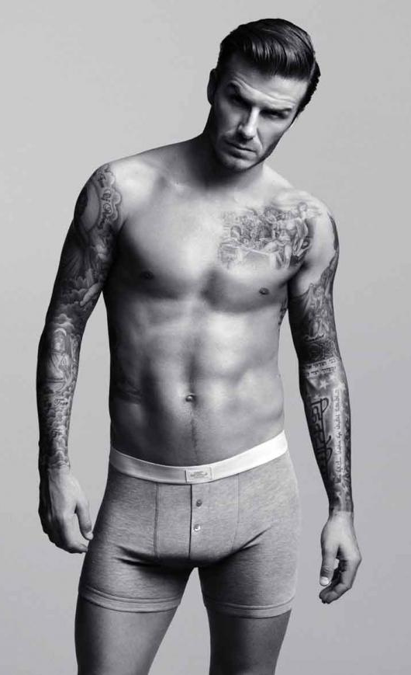
AO1: Demonstrate knowledge and understanding of media concepts, contexts and critical debates.
So, is the female gaze ‘drowned out’?
How is the gaze gendered in this image of David Beckham?
Team A:
Argue that the gaze is gendered as female
Team B:
Argue that the gaze is gendered as male

Slide 41
The ‘female gaze’ and representation
AO1: Demonstrate knowledge and understanding of media concepts, contexts and critical debates.
So, what does this have to do with representation? How does it affect our way of understanding women and men in moving media texts?
If men looking at women is the ‘norm’ then what happens when a woman looks at a man?
Let’s look at some examples…

Slide 42
Spartacus (1960) and Gladiator (2000)
You will watch two clips from each film, focusing on the connotations of
‘the female gaze’ within the film.
Clip 1 from each film shows a woman gazing at a man. What sort of
character is this woman? How does she relate to the men around her?
What are the connotations of the way she looks at the man? Is she a
positive or negative figure? Is she stereotypically masculine or
feminine? Is she active or passive?
Clip 2 from each film shows a man being gazed at by other men. How
does he react? How does it affect his ‘masculine’ status? Is he in an
active or passive role?
How does all this affect our view of women looking at men or men
looking at women? Is the year the films were made significant at all?
Fill in the table on your sheet with your ideas.

Slide 43
AO1: Demonstrate knowledge and understanding of media concepts, contexts and critical debates.
Why is the gaze important when considering representation?
Watch the clip about Charlie’s Angels and make notes on female empowerment and sexuality. Are they mutually exclusive? Does Schroeder’s belief apply?
Do you agree?

Slide 44
AO1: Demonstrate knowledge and understanding of media concepts, contexts and critical debates.
A more current example: does Katy Perry prove Schroeder wrong?
Katy Perry, ‘Roar‘, directed by Grady Hall and Mark Kudsi.
How is the gaze constructed in this video?
Is Katy Perry objectified?
Are we (‘the gazer’) more powerful than she is?
Also consider: what other representations of Perry are there in this video? Is she masculine or feminine – or both? Is she powerful? Dominant? Submissive? How does the video use gender codes? Mind map some ideas on your tables.

Slide 45
AO1: Demonstrate knowledge and understanding of media concepts, contexts and critical debates.
Let’s try analysing some case studies, bringing together everything we’ve learned:
Constructionist approach
Queer Theory
Goffman’s gendered codes of advertising
Mulvey’s concept of the gaze
Warning! You’ll then use these (and/or the other texts we’ve analysed) to answer a practice exam question.
Constructionist approach – a reminder:
The thing itself / the opinion of the encoder / reading and response of audience / context of society within which the representation takes place

Slide 47
AO1: Demonstrate knowledge and understanding of media concepts, contexts and critical debates.

Slide 48
AO1: Demonstrate knowledge and understanding of media concepts, contexts and critical debates.

Slide 49
AO1: Demonstrate knowledge and understanding of media concepts, contexts and critical debates.
TV advert ‘Tattoo’
Superiority, Domination & Body Language: Men are shown in dominant positions and appear to be reflective of thought and intelligence. Women are physically portrayed in sexual or reclining poses with blank or inviting expressions.
Dismemberment: On females, parts of the body such as legs, chest, etc., are used, rather than the full body. This is often applied to sell products which are not related to the body.
The Voice-Over Authority: In moving image advertisements, male voices are used as voice-overs in commercials rather than females.
The thing itself / the opinion of the encoder / reading and response of audience / context of society within which the representation takes place
?
How is the gaze gendered?

Slide 50
AO1: Demonstrate knowledge and understanding of media concepts, contexts and critical debates.

Slide 51
AO1: Demonstrate knowledge and understanding of media concepts, contexts and critical debates.

Slide 52
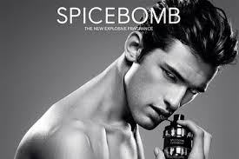
AO1: Demonstrate knowledge and understanding of media concepts, contexts and critical debates.
TV advert ‘Spicebomb’
Superiority, Domination & Body Language: Men are shown in dominant positions and appear to be reflective of thought and intelligence. Women are physically portrayed in sexual or reclining poses with blank or inviting expressions.
Dismemberment: On females, parts of the body such as legs, chest, etc., are used, rather than the full body. This is often applied to sell products which are not related to the body.
The Voice-Over Authority: In moving image advertisements, male voices are used as voice-overs in commercials rather than females.
The thing itself / the opinion of the encoder / reading and response of audience / context of society within which the representation takes place
?
How is the gaze gendered?

Slide 53
AO1: Demonstrate knowledge and understanding of media concepts, contexts and critical debates.

Slide 54
AO1: Demonstrate knowledge and understanding of media concepts, contexts and critical debates.

Slide 55
AO1: Demonstrate knowledge and understanding of media concepts, contexts and critical debates.
TV advert ‘Cherie’
Superiority, Domination & Body Language: Men are shown in dominant positions and appear to be reflective of thought and intelligence. Women are physically portrayed in sexual or reclining poses with blank or inviting expressions.
Dismemberment: On females, parts of the body such as legs, chest, etc., are used, rather than the full body. This is often applied to sell products which are not related to the body.
The Voice-Over Authority: In moving image advertisements, male voices are used as voice-overs in commercials rather than females.
The thing itself / the opinion of the encoder / reading and response of audience / context of society within which the representation takes place
?
How is the gaze gendered?

Slide 56
AO1: Demonstrate knowledge and understanding of media concepts, contexts and critical debates.

Slide 57
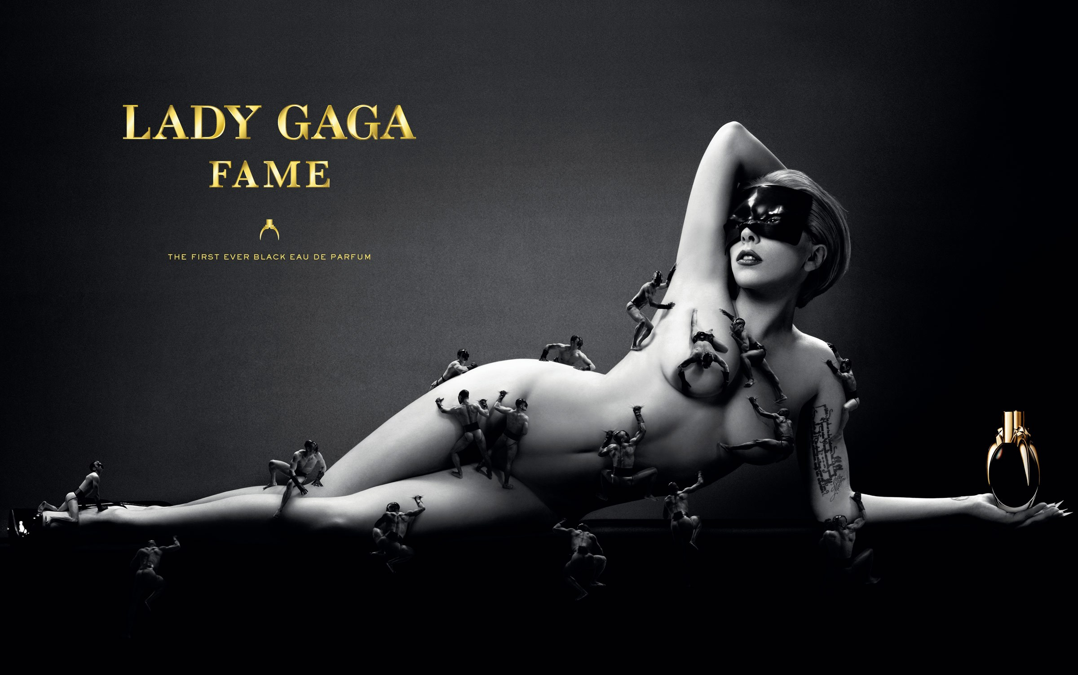
AO1: Demonstrate knowledge and understanding of media concepts, contexts and critical debates.

Slide 58
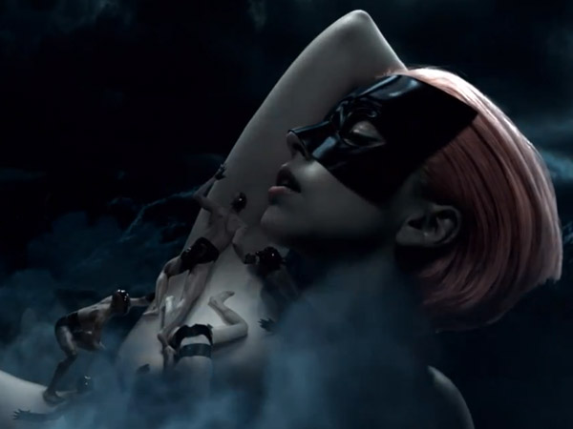
AO1: Demonstrate knowledge and understanding of media concepts, contexts and critical debates.
TV advert ‘Fame’
Superiority, Domination & Body Language: Men are shown in dominant positions and appear to be reflective of thought and intelligence. Women are physically portrayed in sexual or reclining poses with blank or inviting expressions.
Dismemberment: On females, parts of the body such as legs, chest, etc., are used, rather than the full body. This is often applied to sell products which are not related to the body.
The Voice-Over Authority: In moving image advertisements, male voices are used as voice-overs in commercials rather than females.
The thing itself / the opinion of the encoder / reading and response of audience / context of society within which the representation takes place
?
How is the gaze gendered?

Slide 59
AO1: Demonstrate knowledge and understanding of media concepts, contexts and critical debates.
women / men

Slide 60
AO1: Demonstrate knowledge and understanding of media concepts, contexts and critical debates.

